Slide 1
Reporting violence against women
Aboriginal and Torres Strait Islander women’s experiences of violence

Slide 2
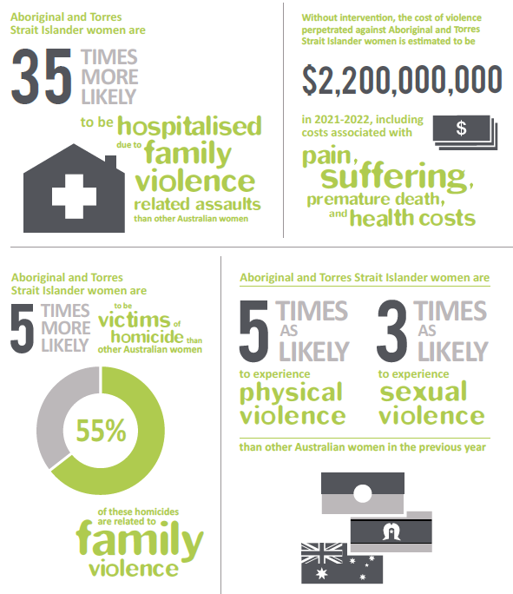
Notes:
Source: Australian Bureau of Statistics Personal Safety Survey, 2012/Graphic from OurWatch: Reporting on Domestic Violence. September 2014.
https://www.ourwatch.org.au/MediaLibraries/OurWatch/Images/ourwatch_reporting_on_domestic_violence_aa_v1.pdf

Slide 3
We must do our job
Violence against Aboriginal and Torres Strait Islander women is an important news story, and reporting it is part of our job as journalists. We should not shy away because of our own ignorance or lack of confidence.
However:
We must be aware of our own cultural biases and prejudices
For most of us, there are extra layers of sensitivities and difficulties to negotiate if we are to do a good, constructive job

Slide 4
“Just about every woman has her own story; we just need to listen. It is a sad truth that many Aboriginal and Torres Strait Islander women continue to be silenced by families, communities and systems. It is a sad truth that Aboriginal and Torres Strait Islander women and their cultural needs continue to be invisible to policy and lawmakers. It is a sad truth that many Aboriginal and Torres Strait Islander women get poor responses from the very system that is meant to protect them.”
Antoinette Braybrook CEO of the Aboriginal Family Violence Prevention and Legal Service
Notes:
The Long Walk Women’s Luncheon – keynote address, (2015).

Slide 5
Context
Family violence in Aboriginal and Torres Strait Islander communities occurs in the context of violent colonisation, dispossession, denial of culture, a breakdown of traditional kinship systems and the forced removal of children from their families
Relatedly, many Aboriginal and Torres Strait Islander people live with enormous socio-economic disadvantage
Family violence is not an aspect of ‘traditional’ Indigenous cultures: be sure not to suggest that culture or ethnicity explains violence

Slide 6
Guidelines Getting information
Take the time to learn the protocols of your local Aboriginal and Torres Strait Islander communities
Develop a range of contacts in local Aboriginal and Torres Strait Islander communities rather than identifying one person as a spokesperson on all issues
Victims may be at greater risk in small and isolated communities
Don't be afraid to admit your own ignorance. Ask for suggestions on where to go, and who to talk to
Notes:
Sheridan-Burns, Lynette and McKee, Alan (1999) Reporting on Indigenous Issues: some practical suggestions for improving journalistic practice in the coverage of indigenous affairs. Australian Journalism Review, 21(2):pp. 103-116.

Slide 7
Guidelines Getting information
Do not take refusal to speak as hostility. There may be many reasons that people are reluctant to talk. Ask for alternatives
Be patient: it may take longer to interview Indigenous people
Don't be embarrassed by silence in interviews
Be aware that in some Indigenous cultures, staring is rude
Ask about cultural differences when reporting grief. In some Indigenous communities, the name or image of a recently deceased person should not be used. Seek the permission of the deceased’s family
Notes:
Sheridan-Burns, Lynette and McKee, Alan (1999) Reporting on Indigenous Issues: some practical suggestions for improving journalistic practice in the coverage of indigenous affairs. Australian Journalism Review, 21(2):pp. 103-116.

Slide 8
Guidelines Presenting the story
Remember that although Aboriginal and Torres Strait Islander people are more likely to be victims of violence, the perpetrator is not always another Aboriginal and Torres Strait Islander
Not every story about violence against Aboriginal and Torres Strait Islander women is about indigeneity
Consider giving some cultural context and the history of the community involved
When looking at social problems consider presenting solutions and active responses from community members
Notes:
Sheridan-Burns, Lynette and McKee, Alan (1999) Reporting on Indigenous Issues: some practical suggestions for improving journalistic practice in the coverage of indigenous affairs. Australian Journalism Review, 21(2):pp. 103-116.

Slide 9
Examples
9

Slide 10
Resources and Help
Services for Journalists and Students
DART Self-care resources available at http://dartcenter.org/topic/self-care
Please seek out your University Counselling Services
Other Services
These organisations offer 24/7 telephone support and counselling services, and online chat, for specific groups and for people in specific situations.
1800 RESPECT
The national sexual assault, domestic and family violence counselling service. 24/7 phone and online services.
1800 737 732
KIDS HELPLINE
Kids Helpline is a counselling service for Australian children and young people aged between 5 and 25 years. 24/7 phone and online services
1800 55 1800
MENS LINE
Professional support and information service for Australian men. 24/6 phone and online services.
1300 78 99 78
MEN’S REFERRAL SERVICE (MRS)
MRS provides anonymous and confidential telephone counselling, information and referrals to men to help them take action to stop using violence and controlling behaviour.
1300 766 491
NAPCAN
Go to the Urgent Help section of the National Association for Prevention of Child Abuse and Neglect (NAPCAN) website for contact details of agencies which assist with reporting child abuse and neglect.

Slide 11
References
ABC (2015) ‘Indigenous Content Guidelines’ https://edpols.abc.net.au/guidance/abc-indigenous-content/
ABC (2014) ‘ABC Reconciliation Action Plan 2013-15: First report against the Plan, January-December 2013’, http://about.abc.net.au/wp-content/uploads/2014/08/ABC-RAP-Report-2013-2.pdf
Bowden, T. (2015) ABC Online, ‘ “I can’t hide my scars”: Woman who lost eye in hammer attack speaks out against domestic violence’, 25 November, http://www.abc.net.au/news/2015-11-25/marlene-tighe-loses-eye-teeth-after-being-beaten-by-partner/6973972
Braybrook, A. (2015) Aboriginal Family Violence & Legal Service Victoria, ‘The Long Walk Women’s Luncheon – keynote address’, 16th October, http://www.fvpls.org/images/files/Long%20Walk%20Women's%20Luncheon%20AB%20speech.pdf
Korff, J. (2015) Creative Spirits, ‘Mainstream media coverage of Aboriginal issues’, http://www.creativespirits.info/aboriginalculture/politics/media-coverage-of-aboriginal-issues#axzz3swOseRcy
Gregory, K. (2015) ABC Online, ‘Bagot Indigenous leader slams broadcast of Darwin domestic violence offender sentencing’, 17 September, http://www.abc.net.au/news/2015-09-16/community-reacts-to-domestic-violence-sentencing-broadcast/6779842
Human Rights and Equal Opportunity Commission (1991), ‘Racist Violence: Report of the National Inquiry into Racist Violence in Australia’, https://www.humanrights.gov.au/sites/default/files/document/publication/NIRV.pdf
McCallum, K., Meadows, M., Waller, L., Dunne Breen, M., Reid, H. (2012) The Media and Indigenous Policy: How media reporting and mediatized practice impact on Indigenous policy – A preliminary report, Journalism & Communication Studies, University of Canberra.
Our Watch (2014) ‘Reporting on Family Violence in Aboriginal and Torres Strait Islander Communities’, https://www.ourwatch.org.au/MediaLibraries/OurWatch/Images/ourwatch_reporting_on_a-ts_family_violence_aa_v1.pdf
Our Watch, (2014), ‘Reporting on Domestic Violence, https://www.ourwatch.org.au/MediaLibraries/OurWatch/Images/ourwatch_reporting_on_domestic_violence_aa_v1.pdf
Owen, M. (2015) The Australian, ‘Domestic violence behind spikes in indigenous jail numbers: John Rau’, 15 September, http://www.theaustralian.com.au/national-affairs/indigenous/domestic-violence-behind-spike-in-indigenous-jail-numbers-john-rau/news-story/c6b4a43dabbc638d8752a7e7862be08f
Porter, A. (2015), ‘Riotus or Righteous Behaviour? Representations of Subaltern Resistance in the Australian Mainstream Media’, Current Issues in Criminal Justice, 26(3), 289-304.
Royal Commission into Aboriginal Deaths in Custody (1987) ‘National Report Volume 2’, http://www.naccho.org.au/download/aboriginal-health/deaths%20in%20custody%202.htm
Sheridan-Burns, L. and McKee, A. (1999), ‘Reporting on Indigenous Issues: some practical suggestions for improving journalistic practice in the coverage of indigenous affairs’ Australian Journalism Review, 21(2), pp.103-116
Stockwell, S. and Scott, P. (2000), All-Media Guide to Fair and Cross-Cultural Reporting: For Journalists, program makers and media students, Australian Key Centre for Cultural and Media Policy.

