Slide 1
Reporting violence against women
The gendered newsroom

Slide 2
Coverage over time
2
Notes:
This graph is sourced from a Factiva search of ‘violence against women’ or ‘domestic violence’ or ‘family violence’ or ‘intimate partner violence’ within the time period 1 January 2000 – 31 December 2017. The search is Australia wide, including all publication and web news but not blogs, pictures or multimedia. It is also excluding republished news, pricing or market news or obituaries, sports and so forth.

Slide 3
The context for media reporting
Newsrooms are not neutral places. Gender political issues can be important there too
Only a few women are found on the board and senior management teams of Australian private media companies
There are very few female editors of Australian daily mainstream mastheads and very few other senior women editors
In one week, women wrote only a third of opinion pieces across 27 mastheads
On one day across nine mastheads, fewer than one in three stories were written by women
3
Notes:
Bacon, W. et al. (2013) “Women in the Media” http://www.wendybacon.com/investigations/women-in-the-media

Slide 4
Gender divide in newsrooms
4
Notes:
International Women’s Media Foundation (2011) Global Report on the status of women in the news media. p. 217 https://www.iwmf.org/wp-content/uploads/2018/06/IWMF-Global-Report.pdf

Slide 5
Women in the industry
A recent survey of 1000 women in the media industry found:
41% women said they’d been harassed, bullied or trolled on social media, while engaging with audiences; several were silenced or changed their career
Almost half (48%) said they’d experienced intimidation, abuse or sexual harassment in the workplace
A quarter of women who’d taken maternity leave said they’d been discriminated against, upon return to work
One in three (34%) said they didn’t feel confident to speak up about discrimination
5
Notes:
Women in Media (2016), ‘Mates over Merits: Women in the Media Report’, http://womeninmedia.net/portfolio-item/media-release-mates-over-merit-the-women-in-media-report/

Slide 6
Women in the news
Women make up only about 24 per cent of those quoted or mentioned in Australian media
In sport coverage, it is less than one percent
These figures have barely budged over the last five years
6
Notes:
Global Media Monitoring Project http://whomakesthenews.org

Slide 7
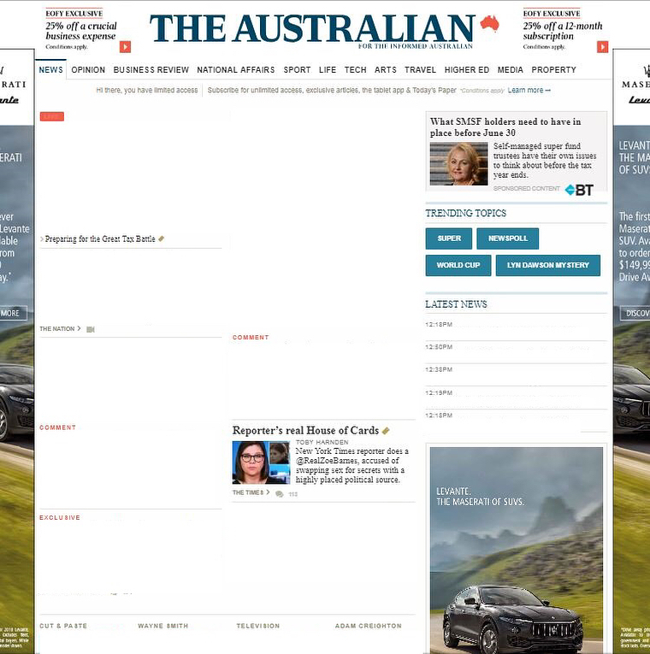
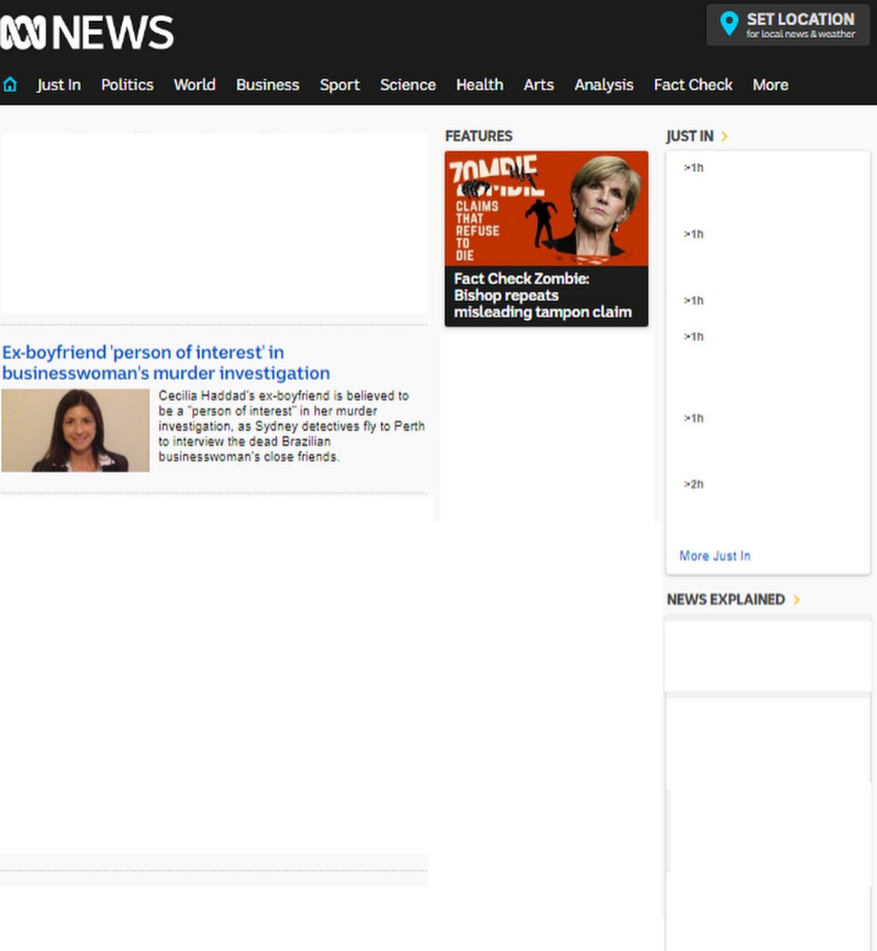
‘Front Pages Without Males’ (IG @frontpageswithoutmales) highlights the lack of visibility of women in the news
7
Notes:
The Australian: https://www.instagram.com/p/BkJsLaWDgPX/
ABC: https://www.instagram.com/p/BiTQA0dDZHQ/

