Slide 1
Reporting violence against women
Lesson two: Finding things out

Slide 2
Taking care of yourself and others
Family violence is common
We can be almost certain that the issues we are raising will be directly relevant to some of the people in this room
Because of this, some people might find the content confronting or triggering
If you need to take a break, please do so

Slide 3
Taking care of yourself and others
While we acknowledge and support you, this is not the place to reveal sensitive personal information
If you want to seek more help, please see the resources listed at the end of this presentation
Even if none of this applies to you, please be mindful about others, and take care to discuss and debate the issues with respect and consideration for your classmates

Slide 4
Everyone can find this content challenging
Most men are not violent. If you are not a violent man, we are not talking about you when we discuss perpetrators of violence
Violence against women is not a women’s issue. It is an important social issue, and men and women can and should play a positive role to prevent it

Slide 5
Finding things out
Journalism has two sides: finding things out and communicating the results
In this lesson we are concentrating on the first aspect of that job
Three parts to this lecture:
Understanding what you are seeing
Sources
Interviewing victims and survivors

Slide 6
1
Understanding what you are seeing

Slide 7
Understand what you are seeing
Most family violence is never reported to the police, and does not end up before the courts
Some kinds of violence, including financial control, surveillance and verbal and psychological abuse, may not even be crimes
Be aware of the potential family violence background to other stories, and alert to the issues involved in doing your research and dealing with your sources

Slide 8
Understand what you are seeing
Be alert to the possible family violence background to stories about:
Homelessness
Marital breakup
Work absences or under-performance
Stress, depression and other mental health issues
Children’s behavioral problems
And a host of other issues
All this has implications for what sources are relevant, and how you will frame your story

Slide 9
Different kinds of stories Crime stories and court reporting
Crime and court reporting are the most visible but least common manifestation of family violence in the news
Homicides and serious assaults tend to end up before the courts Other domestic assaults usually do not
Other kinds of abuse, such as financial control, verbal and psychological abuse and some kinds of stalking may not be crimes

Slide 10
Different kinds of stories Crime stories and court reporting
Police and the courts are obvious and important sources – but not the only sources
There are often legal restrictions on identifying children and the victims of sexual assaults, which may also prevent you identifying the alleged perpetrator. These vary from state to state
Before conviction, you must avoid any reporting that assumes guilt, or goes beyond the “bare facts” of the charge and circumstances and evidence given in court

Slide 11
Different kinds of stories Events and response stories
Includes statements by politicians, releases of statistics, appearances by newsworthy spokespeople, announcements of new initiatives to address the problem, etc.
These are opportunities to not only report the news, but provide context and information
They are also opportunities to ask informed questions of policy makers, police, survivors, community leaders and others

Slide 12
Different kinds of stories Issue-based and personal stories
Issue based stories
Prevalence in a local community, impact on other issues such as homelessness, implications for employers, schools, lawyers, teachers
Personal stories
Standalone stories – often concerning prominent people
Stories run as illustrations or examples (often accompanying one of the types of stories above)

Slide 13
Reporting on Aboriginal and Torres Strait Islander communities
Aboriginal and Torres Strait Islander women are much more likely to be targeted for violence than non-Indigenous women
Good reporting requires cultural sensitivity, for example:
avoid suggesting that violence is inherently part of Indigenous culture
remember to put safety first: don’t place your source in danger
try to make sure you are interviewing people who have the respect of the community
be aware that violence in Indigenous communities often takes place in a context of dispossession and disadvantage
Always refer to the National Best-Practice Guidelines on Reporting on Family Violence in Aboriginal and Torres Straight Islander Communities

Slide 14
2
Sources

Slide 15
What the research tells us
The choice of sources in reporting family violence indicates to readers who is regarded as an authority on an issue
Half the sources used are police or from the criminal justice system
29% of sources are politicians
Only 10% of sources were violence against women experts/advocates
Only 9% of sources were survivors
Notes:
ANROWS and Our Watch, (2016) ‘Media Representations of violence against women and their children: Final Report’, Horizons, 3.

Slide 16
Sources
The reporting of VAW is a great example of how journalistic sourcing works, and interacts with power
Sources must be credible
Sources must be verifiable, and/or named
Sources tend to be powerful people, or those that have some kind of official imprimatur
All this means that when reporting family violence, doing a good job means making an extra effort to find and consider those who do not have equal power to speak

Slide 17
Broadening your sources
Police are an obvious and important source, but be aware they see only a tiny part of family violence. They can sometimes believe myths surrounding family violence
Police statistics under-represent the prevalence of family violence
Facts & Statistics
Australian Bureau of Statistics Personal Safety Survey http://www.abs.gov.au/
Australian Institute of Criminology http://www.aic.gov.au/
Australian National Research Organisation for Women’s Safety http://anrows.org.au/
Depending on context, your local community experts, health practitioners, women’s refuge operators etc.

Slide 18
Broadening your sources
Politicians, policy makers, employers and community leaders are natural and important sources – but as with all journalism, they should be held to account
do they understand and address the gendered nature of violence?
are promises of funding adequate, and targeted correctly?
what are they doing about gender equality in their own organisations?
are they saying stupid and sexist things?
Consider taking the opportunity to ask these people about family violence at media conferences and other opportunities

Slide 19
Broadening your sources
Neighbours and colleagues rarely have a good understanding of what happens behind closed doors
The nature of family violence means that the issue is often hidden
The fact that neighbours, family or friends saw the perpetrator as a good person isn’t necessarily relevant or useful: self-evidently, a man who murders his wife and children is not a ‘lovely guy’

Slide 20
Broadening your sources
Violence against women experts and advocates can talk about the nature of violence, why it happens, underlying causes, power and control, impacts on victims, accountability for perpetrators, systemic issues
Experts and advocates can make it clear that family violence is almost never a single incident of physical abuse. They can place it in a broader social context
Victims/survivors can offer a personal and human understanding of the issue. Their words often speak to readers on a deeper level than statistics can

Slide 21
The unreliable source
Watch out for sources indicating that VAW is caused by drug/alcohol abuse, poverty, race or ethnicity, a perpetrator ‘just snapping’, mental health, stress or that the victim was partially to blame
When the source is wrong:
Use your judgement – as you do in any other area of news
Just because the source says something dubious or incorrect doesn’t mean you simply report it
Get a counter opinion or a counter statement from a VAW expert

Slide 22
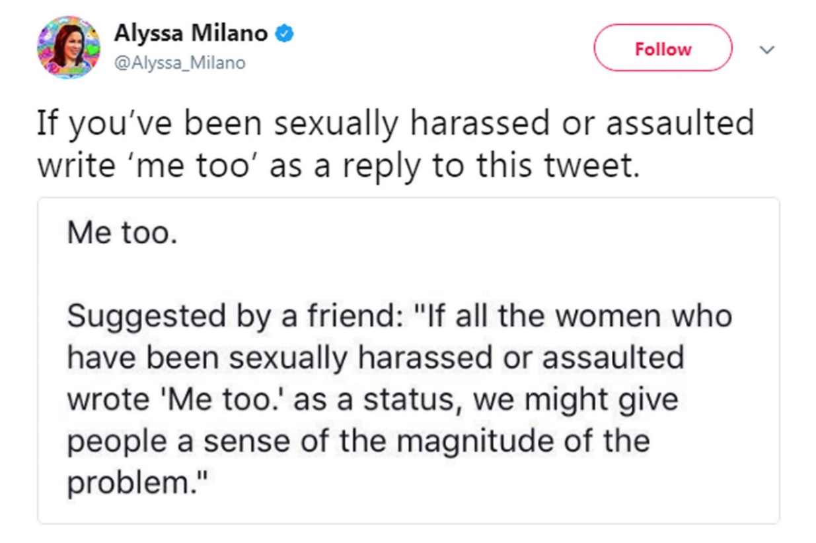
Social media
The #MeToo and Time’s Up movements show that social media can drive public discussion of violence against women while both drawing on and spurring the mainstream media’s reporting
Notes:
https://twitter.com/Alyssa_Milano/status/919659438700670976

Slide 23
Social media
In Australia, journalist Tracy Spicer used social media to source allegations against media figures, notably presenter Don Burke and the late Nine News director, John Sorell
Social media also facilitates abuse: 41% of female journalists said they’d faced online harassment and bullying
But research suggests social media is one of the factors that has driven an increased attention to family violence by journalists

Slide 24
3
Interviewing victims & survivors

Slide 25
Interviewing victims and survivors
It's important to do it – ethically, respectfully and with consent
Traumatic experiences rob people of their sense of self. By telling their story, journalists can help restore it
Failing to the tell the story because of our own timidity or discomfort can be ethically dubious

Slide 26
What the MEAA code says
Do not place unnecessary emphasis on personal characteristics, including race, ethnicity, nationality, gender, age, sexual orientation, family relationships, religious belief, or physical or intellectual disability
Aim to attribute information to its source. Where a source seeks anonymity, do not agree without first considering the source’s motives and any alternative attributable source. Where confidences are accepted, respect them in all circumstances
Use fair, responsible and honest means to obtain material. Identify yourself and your employer before obtaining any interview for publication or broadcast. Never exploit a person’s vulnerability or ignorance of media practice
Respect private grief and personal privacy. Journalists have the right to resist compulsion to intrude
Notes:
Clause 2,3,8 and 11 MEAA code of ethics

Slide 27
Informed consent
A cornerstone of professional ethics
Must be obtained prior to interview or image being taken
Generally speaking, children on their own cannot give consent – ask the responsible adult
Particularly when dealing with victims and survivors, accept that ‘no’ means ‘no’
But – don’t be frightened to ask. Telling stories can be powerful, and is your job!
Notes:
Muller, D. (2011), Media Ethics and Disasters: Lessons from the Black Saturday Bushfires, Melbourne: MUP Academic

Slide 28
Four abilities model of consent
Journalists can use the four abilities model to assess whether a person is capable of providing informed consent
The ability to express a choice;
to understand the meaning of what is proposed;
to appreciate the implications and consequences; and
to arrive at a reasoned decision

Slide 29
Consent after trauma
How can the journalist know about the subject’s state of mind? What can reasonably be expected of the journalist?
Consider consulting local experts or support organisations
Consider seeking a female interviewer or arranging for a female to be present
Take extra care to explain your purpose in an honest and straightforward fashion
Consider checking back with the subject before publication or broadcast
Notes:
Muller, D. (2011), Media Ethics and Disasters: Lessons from the Black Saturday Bushfires, Melbourne: MUP Academic

Slide 30
Safety
Your duty to the public interest and your sources means considering the safety of your interview subject at all times
This has implications for:
Where you conduct the interview
How you communicate with the subject
Whether you identify the subject

Slide 31
Survivor power
Place as much control of the encounter as possible in the hands of the survivor by:
A quiet approach and honest introduction
Conveying that the survivor’s welfare is paramount
Treating the survivor as an equal
Using open questions, allowing the survivor to decide what to talk about and how much to tell
Allowing the survivor to tell the story in her own way without putting words in her mouth
Notes:
Muller, D. (2011), Media Ethics and Disasters: Lessons from the Black Saturday Bushfires, Melbourne: MUP Academic

Slide 32
Different kinds of questions
Open questions
“What would you like to tell me about your experience?”
Closed questions
“Did he hit you?”
No question
“I can’t imagine what it is like to have been through this”
“I admire your strength in choosing to tell your story”
“I don’t understand”
Silence/acknowledgement combined with good listening

Slide 33
Best practice interviewing
Ask mostly open questions
Follow up with questions of clarification and development
Do not push survivors to answer questions they do not want to answer
Do not seek sensationalised details, such as asking the survivor to recount explicit details
Avoid:
saying ‘I know how you feel’. You don’t.
asking ‘How do you feel?’ How do you think?
putting words in their mouth: ‘It must have been...’
asking questions or making comments that imply blame
using inappropriate language to describe abuse

Slide 34
Best practice interviewing
“Please let me know if you would like to stop or take a break.”
“What would you like to tell me about your experience?”
“I can’t imagine what it is like
to have been through this.”
“I admire your strength in choosing to tell your story.”
“I don’t understand.
Can you help me understand?”
Silence and acknowledgement
combined with good listening.
“Did he hit you?”
“Why didn’t you leave?”
“I know just how you feel.”
Putting words in her mouth
Asking questions or making comments that imply blame
Using inappropriate language to describe abuse (e.g. “rape” is not “sex”; “abuse” is not a “volatile relationship”)

Slide 35
Conclusions
Never pressure a victim or survivor to talk, but don’t shy away merely because of your own discomfort
Consent is essential, but requirements can vary with circumstances
Traumatised people can and do make good decisions about consent
The journalist needs to act in ways that put the safety of the interview subject first
Recognise and support vulnerable people’s right to tell their stories
Be careful and self-aware with your language and types of questions

Slide 36
If you or someone you know needs support:

Slide 37
Resources and Help
Services for Journalists and Students
DART Self-care resources available at http://dartcenter.org/topic/self-care
Please seek out your University Counselling Services
Other Services
These organisations offer 24/7 telephone support and counselling services, and online chat, for specific groups and for people in specific situations.
1800 RESPECT
The national sexual assault, domestic and family violence counselling service. 24/7 phone and online services.
1800 737 732
KIDS HELPLINE
Kids Helpline is a counselling service for Australian children and young people aged between 5 and 25 years. 24/7 phone and online services
1800 55 1800
MENS LINE
Professional support and information service for Australian men. 24/6 phone and online services.
1300 78 99 78
MEN’S REFERRAL SERVICE (MRS)
MRS provides anonymous and confidential telephone counselling, information and referrals to men to help them take action to stop using violence and controlling behaviour.
1300 766 491
NAPCAN
Go to the Urgent Help section of the National Association for Prevention of Child Abuse and Neglect (NAPCAN) website for contact details of agencies which assist with reporting child abuse and neglect.

