Slide 1
Reporting violence against women
Objectivity and family violence

Slide 2
Objectivity?
Impartial
Disinterested
Balanced
Unbiased
Straight down the middle
Fair
2

Slide 3
Balance?
Tobacco lobby v public health
Climate change v climate change sceptics?
Holocaust deniers v Holocaust survivors?
Creation v evolution?
Abusers and abused?
3

Slide 4
“Fairness and balance take on a new meaning. Rather than high principles, they are really techniques – devices – to help guide journalists in the development and verification of their accounts. They should never be pursued for their own sake or invoked as journalism’s goal. Their value is in helping us to get closer to more thorough verification and a reliable version of events.”
Bill Kovach and Tom Rosenstiel

Slide 5
The discipline of verification
Balance – can lead to distortion
Fairness – does not mean being even-handed, but fair to the FACTS
Passion is not wrong – but minds must stay open. The evidence must be heeded
5

Slide 6
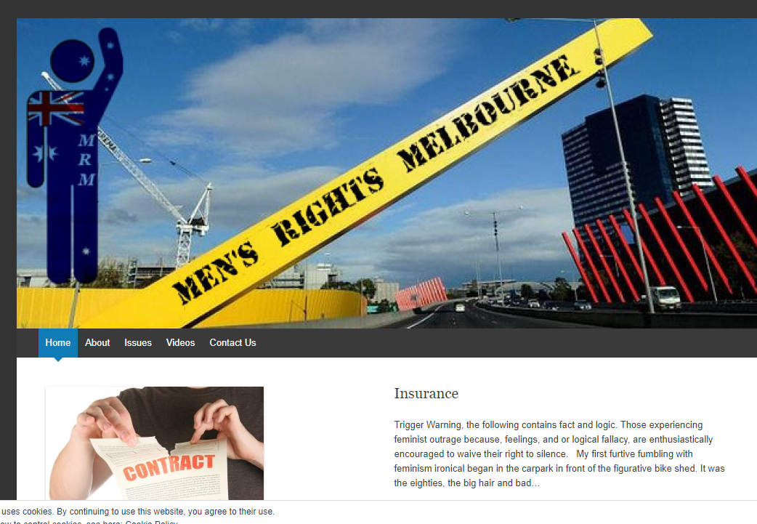

Slide 7
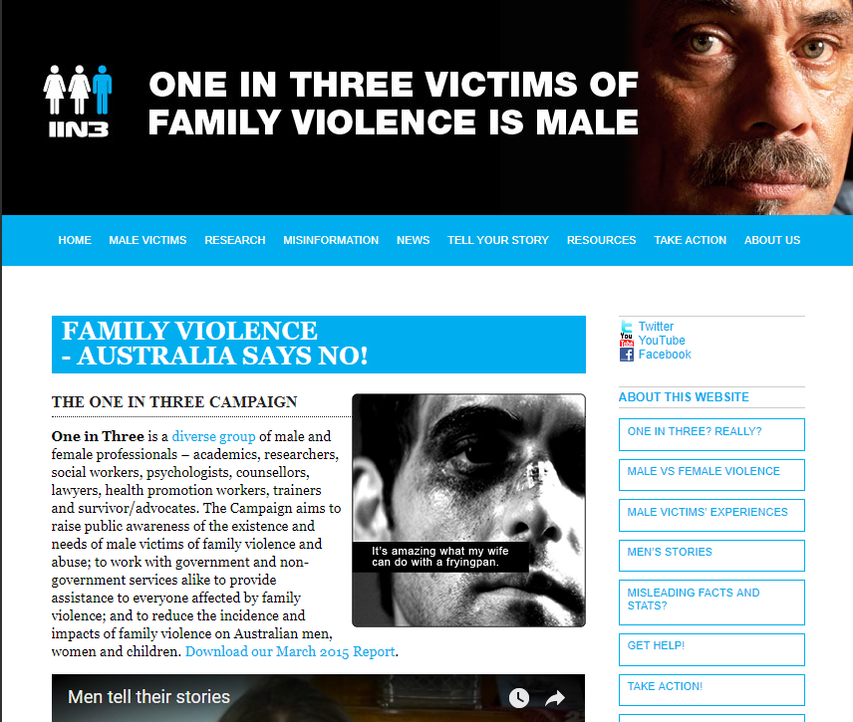

Slide 8
The evidence
Australian Institute of Criminology
Women continue to be over-represented as victims of intimate partner homicide, accounting for 79% of all intimate partner homicides.
Australian Bureau of Statistics Personal Safety Survey
In 2012, 17% of all women and 5% of men had experienced violence by a partner since the age of 15.
Police and crime statistics
Police across Australia dealt with 239,846 domestic violence incidents in 2015, an estimated 657 domestic violence matters on average every day of the year (or one every two minutes) – calculated for police data sourced across all states and territories.
NSW Coroner’s Court Domestic Violence Review Team
Between 2000 and 2014, 159 women were killed by men who abused them, but not one man was killed by an abusive female partner.
8

Slide 9
Violence is gendered
}
1 in 3 women
1 in 2 men
have experienced
physical violence
by a partner, other known person or stranger
}
3 million men
1.1 million women
have experienced violence by a stranger
}
1 in 5 women
1 in 22 men
have experienced
sexual violence
by a partner, other known person or stranger
1.5 million women .45 million men
have experienced violence by a cohabiting partner
Both women and men are 3x more likely to be physically assaulted by a man
Source: ANROWS, (2015). ‘Violence against women in Australia: Additional analysis of the Australian Bureau of Statistics’ Personal Safety Survey, 2012: Key findings and future directions’, Compass, 2, 1-8.
9
Notes:
The ABS Survey showed that men were more likely to be victims of physical violence while women were more likely to be victims of sexual violence
The violence experienced by men and women had some different characteristics:
The most common place for violence to occur for women was in her home and by a cohabitating partner, and for men – violence most commonly occurred in his place of entertainment and by a stranger.
However, both women and men were three times more likely to be physically assaulted by a man.
Source: ANROWS, (2015). ‘Violence against women in Australia: Additional analysis of the Australian Bureau of Statistics’ Personal Safety Survey, 2012: Key findings and future directions’, Compass, 2, 1-8.

Slide 10
The true meaning of objectivity
Find credible sources of evidence
Take the time to learn what the evidence says
Report in line with that evidence
10

