Slide 1
Respect and Equality in TAFE
Building a TAFE environment that promotes gender equality and respect
Notes:
Opening (10 minutes)
Before the training:
You may want to include your TAFE’s branding on these slides.
Note that Our Watch and Department of Education and Training have endeavoured to ensure that the information contained in this training is correct and current at the time of publication. It is at the discretion of the user to deliver the training as outlined and no responsibility is taken by Our Watch or Department of Education and Training if content is altered or omitted. All information is current at May 2021.
Timing: 1 min
Facilitator notes:
Welcome participants to the training session for TAFE leaders and taskforce members
Introduce yourself and give a brief background of your role. Explain that this workshop has been specifically developed by experts at Our Watch, Australia’s national institution in the primary prevention of violence against women and their children, and Department of Education and Training.

Slide 2
Acknowledgments
Notes:
Opening total time: 10 mins
Timing: 1 min
Facilitator notes:
Add your TAFE’s acknowledgement of country here, noting the traditional custodians of the land on which your training is taking place.
Before the training:
Find out about the traditional custodians of the land and water of your local area and their history so you can personalise and localise your Acknowledgement of Country, and make it as meaningful as possible.
You may want to incorporate images that reflect your TAFE’s engagement with local Aboriginal or Torres Strait Islander communities.
Facilitator notes:
Deliver an Acknowledgement of Country.

Slide 3
Expectations
Respectful conversations – challenge ideas, not people
Practice self-care
Keep this as a learning space, not a therapeutic space
Commitment to participating
Be present – mobile phones off or on silent and please keep cameras on if possible
Let’s keep to time!
Notes:
Timing: 3 mins
Facilitator notes:
Outline your expectations to ensure a safe and supportive environment for all participants during the training. Ask about any additional rules the group think should be added.
Ask that participants be respectful.
Encourage everyone to participate and ask questions. If face-to-face, ask participants to turn mobile phones to silent. If online, remind people to mute themselves when they’re not speaking, and encourage people to keep their screens on and use the chat function (if appropriate).
Acknowledge that violence against women is prevalent, and it’s likely that participants in this training will know someone, are someone, or love someone who is a victim/survivor of violence. These issues can sometimes bring up intense feelings, and it is important to practice self-care. Anyone can pass on an activity or step out if they need to, and available support services will be shared on the next slide.
Encourage people to be cautious about the details they are disclosing to the group. While some people may feel comfortable discussing particular topics, it is important to consider the impact this may have on other members of the group. Remind the group this workshop is not a therapeutic space and you cannot offer the support required if they disclose violence. Encourage people to make use of support. Your TAFE may have a Family Violence Contact Officer.

Slide 4
Support services
1800RESPECT | MensLine Australia | Men’s Referral Service | State or TAFE-specific services | State or TAFE-specific services
24/7 support for people impacted by sexual assault, domestic violence and abuse 1800 737 732 1800respect. org.au | 24/7 counselling for men with emotional health and relationship concerns 1300 789 978 mensline.org.au | Telephone counselling, information and referral service for men using violent or controlling behaviour 1300 766 491
Notes:
Before the training:
It is recommended you include the details of your TAFEs student support services, EAP, and processes for handling disclosures of violence and harassment. You may choose to put these on screen or develop a handout.
You may want to include appropriate state-based support services. Support directories for state-based services can be found at familyviolencelaw.gov.au/get-help or anrows.org.au/support-directory. Consider including support services for Aboriginal and Torres Strait Islander people, LGBTIQ+ communities and multicultural communities.
Timing: 2 min
Facilitator notes:
Inform participants that this workshop will cover information about violence against women, and can be personally and professionally challenging. Let participants know that internal and external support services are available if they, or anyone they know, needs support during or after the training. Encourage participants to make note of these services or where they can be found.
Key message: While this is not a therapeutic space, it is important that participants access support should they need it for themselves or others following today’s workshop.

Slide 5
Overview of the workshop
Topic | Content
1. Understand the challenge | The gendered nature of violence against women, including prevalence and impact​ The drivers of violence against women, including misconceptions about what causes violence against women
2. Face the challenge | TAFE as a key setting for primary prevention The whole-of-TAFE framework to primary prevention
3. Own the challenge | The role of the senior leaders and the team (Taskforce) leading this work​
Close | Next steps
Notes:
Timing: 3 mins
Instructions:
This workshop aims to support senior leaders and Respect and Equality in TAFE taskforce members to understand the importance of gender equality and the prevention of violence against women in a TAFE setting and how they can actively support and participate in this work.
By the end of the workshop, participants will have as better understanding of:
Violence against women, including forms of violence, its prevalence, impact and drivers
The drivers of violence against women
TAFE as a key setting for primary prevention, including introducing the whole of TAFE framework
The role TAFEs can play to prevent violence against women and promote gender equality
That everyone in TAFE has a role to play in modelling gender equality and promoting respect
be more confident about how they can support this work as a senior leaders or taskforce member.
Explain the workshop is structured into three topics. The workshop is three hours in total. There will be a summary at the end of the workshop to recap the learning objectives, and go over questions and tips.
Inform the participants that you will now move onto Topic 1, which will be an introduction to violence against women, including types of violence, prevalence rates, and what works to prevent it.

Slide 6
1. UNDERSTAND THE CHALLENGE
Learning outcome:
Understand violence against women is serious, prevalent and preventable
Notes:
Topic 1 total time: 60 mins
Instructions:
This section will look at what is meant by each of these words – serious, prevalent and preventable.
Note that this topic can raise a lot of questions for people so participants are free to ask any clarifying questions as they come up
Note that people can also ask questions at the end of the session if they feel more comfortable

Slide 7
Types of violence
FEAR
POWER
CONTROL
Physical
Social
Emotional
Psychological
Financial
Cultural
Spiritual
Sexual
Notes:
Timing: 5 mins
Facilitator notes:
Briefly discuss examples of different types of abusive and violent behaviour including non-physical forms of coercion. Some examples are:
Physical violence: murder, strangling, choking, punching, throwing objects, reckless driving, cruelty to pets, damage to possessions
Social abuse: includes isolating from friends or family, controlling someone’s appearance, monitoring phone calls or messages, controlling who someone can speak to or see
Emotional/psychological abuse: threats of suicide or self-harm to get someone to do what you want, criticising or blaming someone, implying or spreading rumours of mental illness, minimising or dismissing someone’s feelings or experiences, mind games and ‘gaslighting’ (denying or distorting the truth and causing someone to question their own reality/sanity)
Financial abuse: limiting or denying someone access to finances, incurring debt in someone’s name, not allowing someone to work
Cultural/spiritual abuse: using culture or religion as an excuse for abuse, denying someone the right to practice their religion or engage in cultural practices
Sexual violence: rape, forcing or coercing someone to engage in sexual acts, denying choice in contraception
Inform participants of the following points:
All forms of violence – including non-physical forms of coercion and control – are harmful, and can have devastating long-term impacts on our communities and society.
What is common across the different types of violence is that they are used to create fear and enforce power and control over another person or people in a relationship.
Violence in a relationship is not usually a single act or incident, but a pattern of coercive, humiliating or threatening behaviour that forces people to change their day-to-day behaviour – often in ways that they do not want to – due to fear of more violence and abuse.

Slide 8
Terminology
Violence against women – acts of gender-based violence against women and girls. Most gender-based violence is perpetrated by men against women. In Australia approximately 94% of female victims report a male perpetrator​. The term violence against women includes family violence, dating violence, sexual assault and harassment. It can occur in the home, in public, in workplaces and in education institutions.
Sexual assault and sexual harassment – unwanted or unwelcome sexual behaviour, including unwanted touching and sexual penetration, exposure to sexual acts, and sexual images ta ken without consent. ​
Family and domestic violence – acts of violence, coercion and control perpetrated by someone in a family or family-like relationship, most commonly occurring in the home or in private.​
Violence against LGBTIQ+ people – harmful acts towards someone because of their gender – such as someone from the lesbian, gay, bisexual, trans, intersex, queer and questioning (LGBTIQ+) community.​
Notes:
Timing: 4 mins
Facilitator notes:
Gender-based violence is a broad term that refers to a range of acts of violence against women across multiple contexts – it includes behaviours that are controlling or cause psychological, emotional and financial harm, as discussed in the previous slide.
Many participants may be more familiar with the terms ‘family violence’, ‘domestic violence’, and ‘sexual assault and sexual harassment’, and we still use these terms when we are talking about specific contexts or types of violence.
Note that of course men experience violence too and that all forms of violence are serious. However, the prevalence and nature of violence against women means we need to pay specific attention to it and we need to address preventing it in a particular way.
The statistic on pertaining to male perpetration of violence is evidence in the 2015 ABS Personal Safety Survey, The Men’s Project, 2018 and Our Watch, Change the Story, 2015, Respect@Work, 2020.
Potential resistance:
You may experience resistance to the idea that women experience higher rates of some forms of violence than men. This will be covered further in the session, but helpful statistics include:
1 in 3 Australian women (34.2%) has experienced physical and/or sexual violence perpetrated by a man since the age of 15. (Australian Bureau of Statistics, 2017)
Recent data shows that 75 per cent of victims of family violence are women. (Victorian Government, 2018)
One in two adult Australian women has experienced sexual harassment during their lifetime (Australian Bureau of Statistics, 2017)
Regarding violence experienced by LBGTIQ+ people - Emerging evidence suggests intimate partner violence is experienced at similar or higher rates in same-sex couples as in heterosexual couples, and that experiences of sexual violence and abuse may be higher, particularly for transgender and gender diverse people (Rainbow Health, 2020).
Full references:
Australian Bureau of Statistics, 2017. Personal Safety Survey, Australia, 2016, ABS cat. no. 4906.0. Canberra: ABS.
Victorian Government, 2018. Safe and Strong: A Victorian Gender Equality Strategy. Melbourne: Victorian Government.
Rainbow Health, 2020. Pride in Prevention. Melbourne.

Slide 9
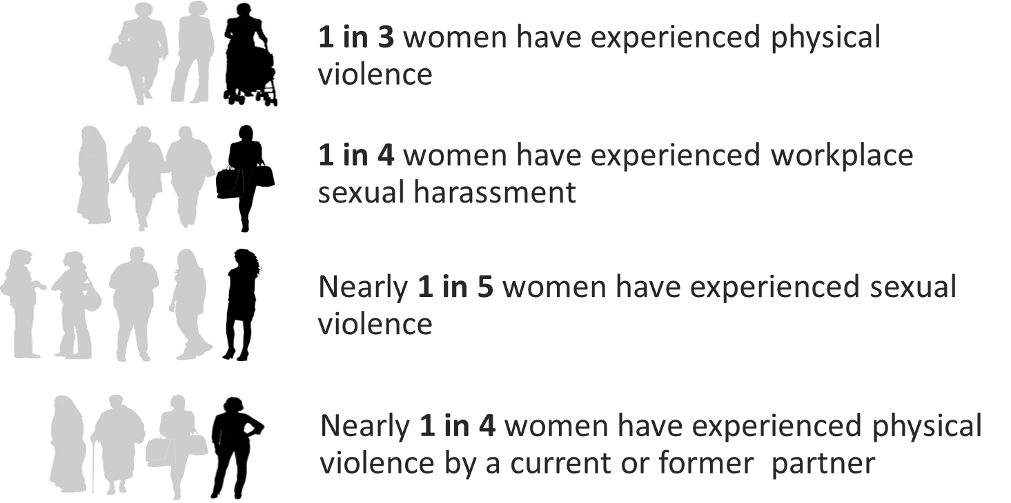
A national crisis
Source: Personal Safety Survey (PSS) 2016
Notes:
Timing: 5 mins
Key message: Women in Australia experience disproportionate and high rates of many different forms of violence.
Briefly introduce these statistics, and explain to the participants:
Violence against women is prevalent, and has a profound impact on women’s health and wellbeing, on families, communities and our society:
Violence from a current or former partner is the third greatest health risk factor for women aged 25-44, with the first being childhood abuse and neglect (AIHW 2019)
Domestic or family violence is a leading driver of homelessness for women (AIHW 2020)
In Australia, one woman is killed every nine days by a current or former partner; and every day, 12 women are hospitalised for assault injuries due to family and domestic violence (AIHW 2019)
Violence against women is costing Australia up to $26 billion each year (KPMG 2016)
Emerging evidence of LGBTIQ+ people’s experience of violence shows:
Same-sex couples (including men) experience partner violence at similar or higher rates as heterosexual couples
Experiences of sexual violence and abuse may be higher, particularly for transgender and gender diverse people (Rainbow Health Victoria 2020)
Women who identify as lesbian or bisexual experience far higher rates of sexual violence than heterosexual women (de Visser et al. 2014)
One in five LGBTIQ+ Australians has experienced physical forms of homophobic abuse (AHRC 2014)
All forms of violence are unacceptable, whether it is perpetrated by men or women. Family, domestic and sexual violence is overwhelmingly perpetrated by men against women:
One in five women and one in 20 men have experienced sexual violence since the age of 15 (ABS 2017)
Women are nearly three times more likely than men to have experienced violence from a former or current partner (ABS 2017)
Recent data from the Victorian Government shows that 75 per cent of victims of family violence are women (Victorian Government 2018)
Additional statistics:
Women are nearly three times more likely to have experienced violence from a former or current partner than men. (Australian Bureau of Statistics, 2017)
One in five Australian women has experienced sexual violence compared to one in 20 Australian men. (Australian Bureau of Statistics, 2017)
Many women who experience family/domestic violence are employed, 30% of workers in a national survey reported having experienced domestic violence during their lifetime. (McFerran, 2011)
In addition to violence experienced at home, women experience significant rates of violence in the workplace. A Victorian survey reported 64% of women have experienced bullying, harassment or violence in their workplace. (Victorian Trades Hall Council, 2017)
One in five LGBTIQ+ Australians has experienced physical forms of homophobic abuse (Australian Human Rights Commission, 2014)
Women who identify as lesbian or bisexual experience far higher rates of sexual violence than heterosexual women (de Visser et al. 2014)
Women and girls with disabilities are at least twice as likely to experience violence as those without disability (Women with Disabilities Victoria, 2013)
One third of the 49 women who lost their lives to gender-based violence in Australia in 2017 were over the age of 60 (Counting Dead Women Australia 2018)
Aboriginal women are 35 times more likely to be hospitalised by family violence than other women. Two in five Aboriginal homicide victims (41 per cent) are killed by a current or previous partner, twice the rate of non-Indigenous victims (22 per cent) (AIHW 2018) Reporting frequently implies that violence against Aboriginal and Torres Strait Islander women is perpetrated only by Aboriginal and Torres Strait Islander men, when non-Indigenous men are also perpetrators, particularly in urban areas (Our Watch, 2018)

Slide 10
Gender and experiences of violence
Men are more likely to experience violence:
From another male
At the hands of a stranger
In a public place
Women are more likely to experience violence:
From a male
At the hands of a current/former partner
In a private place
With a higher risk of serious injury and homicide
That results in fear or anxiety
Notes:
Timing: 3 mins
Key message: Women and men in Australia experience violence in different ways and the violence experienced by women is often more serious and can have devastating impacts on their health and wellbeing.
Facilitator notes:
Briefly explain to the participants:
The evidence also shows that women and men in Australia experience violence differently.
Men are more likely to experience violence from strangers and in a public place. Men are more likely to have one-off experiences of violence than women. The nature of men’s experiences means it is more likely that emergency services will respond quickly.
Women are more likely to know the perpetrator (often their current or former partner), and the violence usually takes place in their home. Women’s experiences of violence are rarely one-off incidents, but are part of a coercive pattern of behaviour with violence increasing in severity and frequency over time. Women can live with violence over a period of weeks, months and years. Women are more than twice as likely as men to experience fear or anxiety due to violence from a former partner, and the nature of their experience often means there is more responsibility placed on them to seek support and/or report violence.
When talking of violence, usually women experience it at the hands of men that they know :
Rarely one-off incident but pattern of control.
Severity and frequency increase over time making it difficult for women to leave.
Make clear that violence against men is also important, but the nature, prevalence and context of gender-based violence is different, so it justifies a different response.
Emphasise that the figures (from the previous slide) give a sense of the magnitude of the problem, and why a whole-of-society response, which includes TAFEs, universities and workplaces, is important to changing the culture that allows violence against women to happen.
Additional information:
It’s important to be clear from the outset that this is not about making men the enemy or saying all men commit violence – the vast majority do not – but if we do not acknowledge the gendered differences of violence then our efforts to prevent violence will not be successful. You may like to frame it as: “all violence is unacceptable, whether it occurs in the home or the workplace, and whether it is perpetrated by men or women.”
Be aware that people may ask about intersectionality – or about how violence is experienced by women who experience intersecting forms of oppression and discrimination. Additional statistics are covered in the next slides.
Regarding what we mean by ‘impact’: This also means that men more than women are much more likely to have one-off experiences of violence. This is not to deny that one-off experiences of violence can have very harmful and long-term impacts including trauma, anxiety and fear. However, there are significant differences in impacts and responses from community and services (men – in public, likely to be perpetrated by a stranger, likely to involve more immediate response from emergency services including medical and legal responses) while women (in private, likely to be perpetrated by a person they love and/ or know and trust, responsibility is placed on them to seek support and/or report the violence)
Women are much more likely to be living with this violence and fear over weeks, months, years, and lifetimes, so this is likely to have even more of an impact.

Slide 11
Different experiences of violence
Aboriginal women are 32 times more likely to be hospitalised as a result of family violence than other women (AIHW 2018).
Women and girls with disabilities are at least twice as likely to experience violence as those without disability (Woodlock et al. 2014).
Some migrant and refugee women may experience controlling behaviours by their partner or extended family using immigration or visa status (El-Murr 2018).
Family violence perpetrated against LGBTI people occurs at similar rates to family violence perpetrated against non-intersex, heterosexual, cis-gendered women (Our Watch 2017).
Notes:
Timing: 3 mins
Key message: It is important to remember that not all women experience violence in the same way and some women face higher rates or more severe impacts.
Facilitator notes:
Talk through the statistics on this slide to highlight that violence is not experienced by all women and LGBTIQ+ people in the same way, and people who face multiple forms of discrimination and inequality experience violence more frequently, more severely, over a longer period of time, and in additional forms (such as denying a women with disability access to her medicine or mobility aids, or threatening to ‘out’ a LGBTIQ+ person).
Make clear that this violence is perpetrated by a range of perpetrators – for instance, both Aboriginal and non-Indigenous men perpetrate violence against Aboriginal women, and immigrant women can experience violence from both immigrant or non-immigrant men.
Sources:
AIHW 2018
Woodlock et al. 2014
El-Murr 2018
Our Watch 2017

Slide 12
Change the story in TAFE
Before presenting please embed the Respect and Equality in TAFE video by following these instructions.
Download the Respect and Equality in TAFE video and save it to your computer- the video is available here: https://assets.ourwatch-campaigns.net/assets/OW-hubs/OURW0031_TAFES_FINAL_CAPTIONS-1.mp4?mtime=20210630125003&focal=none
In PowerPoint go to- Insert > Media > Video > From this device.
Select the video file from where you saved it on your computer
Check that it plays and you are ready to present ☺
Notes:
Timing: 5 mins
Facilitator notes:
Show the video Change the Story: TAFE, by clicking on the image in the slide or access video at [URL when available].

Slide 13
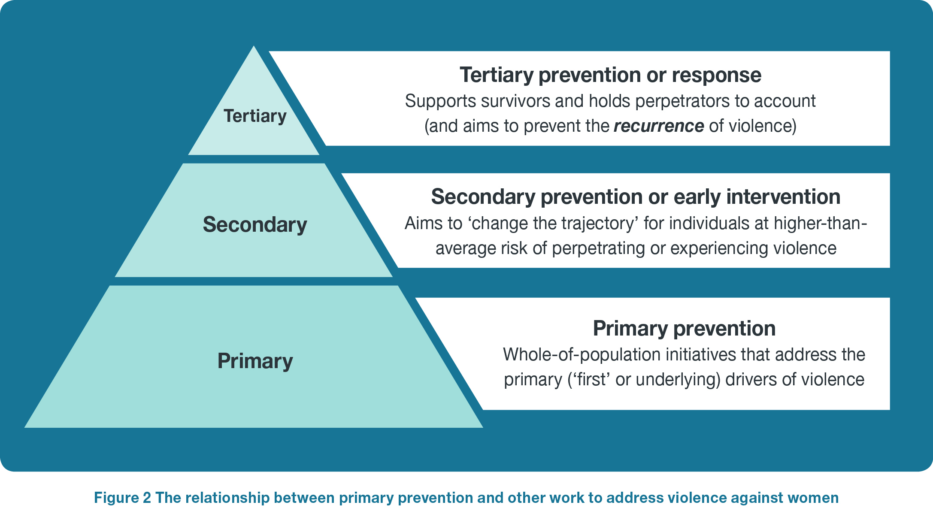
Stopping violence at its source
Notes:
Timing: 3 mins
Facilitator notes:
Explain to participants:
Public health evidence tells us prevention is the most effective way to eliminate violence from our society.
A primary prevention approach means stopping violence before it starts. It means changing the behaviours and norms, across all levels of society, that excuse, justify or allow violence against women to occur.
This approach is guided by a well-established evidence base, and is similar to the approach taken for other major social issues like smoking.
Primary prevention sits alongside other work to address violence against women. Secondary (early intervention) and tertiary prevention (response) focus on providing information and services to people experiencing, or at risk of experiencing, violence. While essential, early intervention and response are unlikely to significantly reduce rates of violence on their own.
Primary prevention takes a whole-of-population approach to addressing the drivers of violence. In TAFEs, this means engaging the whole TAFE community – staff, students, visitors, partners – in work to prevent violence.

Slide 14


A national framework
Notes:
Timing: 5 min
Key message: We have an evidence-base and shared framework that identifies what drives violence against women and the most effective approach to preventing it from occurring in the first place.
Facilitator notes:
Explain to participants:
TAFE’s do not need to do this alone. Australia has a robust evidence base, national organisations like Our Watch and ANROWS, and a world-leading shared policy framework that identifies what drives violence against women, and what works to prevent it.
Change the Story brings together the national and international evidence to show how gender inequality sets the stage for violence to occur. It identifies the key beliefs and behaviours relating to gender (‘drivers’) that drive violence.
Changing the Picture looks at what is needed to address the many drivers of violence against Aboriginal and Torres Strait Islander women.
Counting on Change provides guidance on tracking short, medium and long term progress towards the prevention of violence against women
Note that it is important to keep in mind that the drivers intersect with other forms of inequality like racism, ableism, ageism, classism, homophobia and transphobia. This means that we can be less likely to take seriously violence against some population groups of women, such as trans-women, or find it easier to justify putting limits on their independence, such as women with disability.
Instructions:
In recent years, lots of work has been done to collate and understand Australian and international research about why violence against women occurs, and what the most effective approach is to preventing it.
This has been important because it has helped to identify what really drives violence and to separate some of the more common misconceptions or excuses from what the research and data actually says.
By drawing together this evidence, it allows us to see patterns and correlations that happen across population groups and society as a whole – a whole-of-population approach – which helps us identify what things make a society or community more or less likely to experience violence against women.
A whole-of-population approach to prevention means that we are looking at what is happening for individuals, but also what is happening at the community level, in our workplaces, our schools, TAFE, the media, the arts, and all other aspect of society.

Slide 15
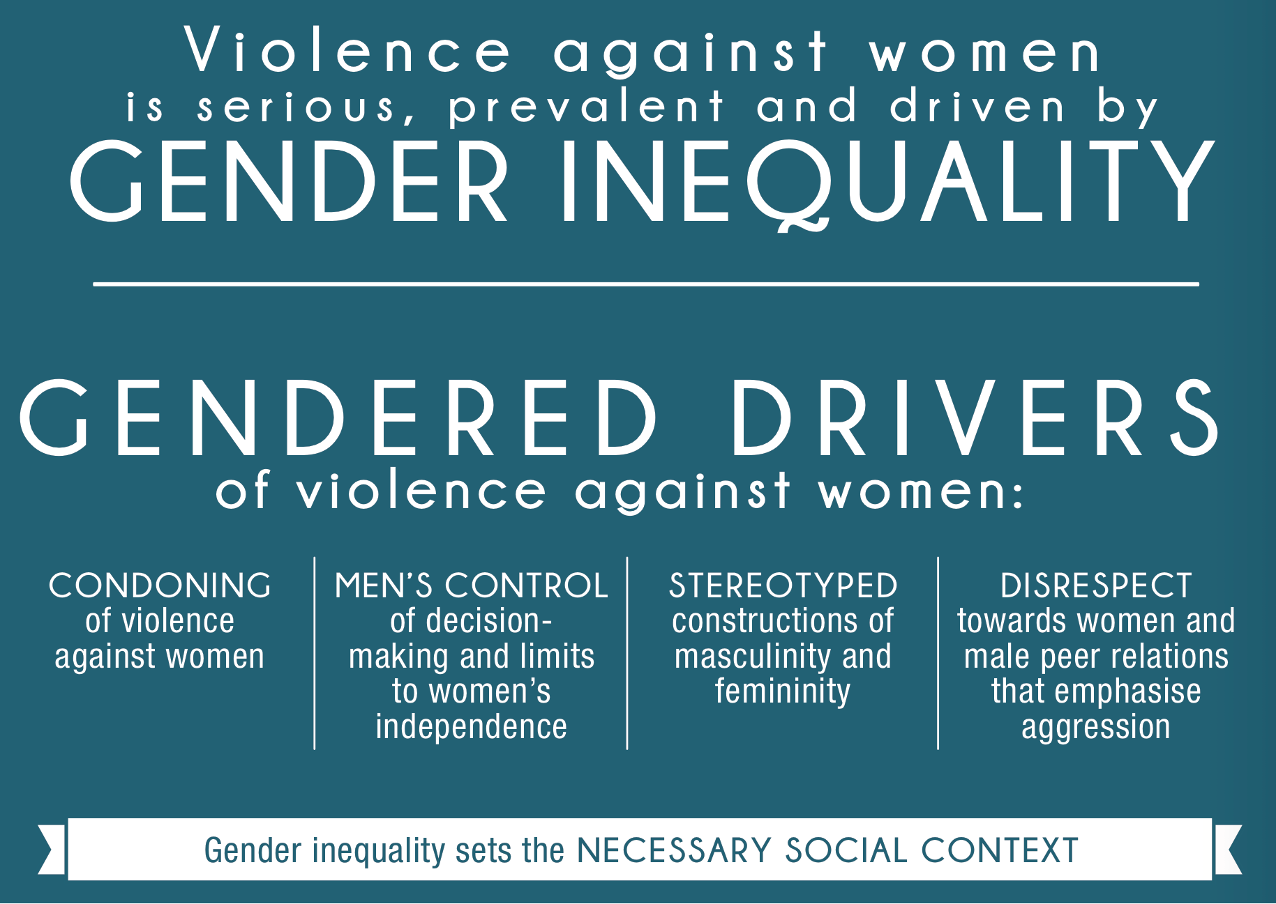
Gendered drivers of violence against women
Notes:
Timing: 30 mins (next four slides)
Key message: Evidence shows that there are four ‘drivers’ that increase the likelihood of violence against women occurring.
Instructions:
This slide shows the four drivers of violence, as identified in Change the story.
International and Australian evidence shows that where these drivers occur across the each of the levels of society, these societies are more likely to experience violence against women.
Facilitator notes:
The evidence base tells us that gender inequality creates the social conditions for violence against women to occur. There are four key expressions of gender inequality that have been found to predict or drive this violence:
Condoning violence against women, where violence is downplayed, excused, justified or denied, or where blame is placed on the victim rather than with the perpetrator. This does not have to be intentional. For example:
Highlighting the victim’s behaviour more than the perpetrator’s violence – like an email telling female students to be more careful walking through the campus at night after a violent assault occurs.
A workplace or organisation failing to hold a staff member or student accountable for sexual harassment.
Sexual harassment policies that focus only on reporting, without onus or organisational duty of care or on bystanders to take action.
Believing women find it flattering to be persistently pursued, even if they’re not interested.
Mistrusting women’s reports of violence – 42% of Australians think it is common for sexual assault accusations to be used as a way of getting back at men.
Minimising intimate partner violence between two men because ‘men should be able to take care of themselves.’
Media portrayals of men who use violence as protective, mentally ill, alcoholic or drug addicts, minimising or excusing their choice to use violence.
Comments or jokes about violence experienced by trans people; “I’d get angry too if I found it wasn’t a real woman”
Rigid gender roles and stereotypes, or assumptions that people are naturally suited to different tasks or have different interests or abilities based on their gender or sexuality. For example:
Marketing campaigns to recruit students to study childcare features only heterosexual, women and families.
Assuming women will do the cleaning, social events, or administrative tasks at work or community events.
Gendered dress codes and school uniforms that restrict girls’ movement and limit their capacity to participate in sports.
Unequal parental leave policies available for men and women in organisations, based on the stereotype and expectation that women will be the main family caregiver.
Lesser value of women’s sporting achievements, demonstrated through lower professional athletes’ salaries, media coverage and sponsorship opportunities.
The double standard where men displaying assertiveness and leadership qualifies are admired, while women with the same qualities may be considered bossy or cold.
Asking people in a same-sex relationship who is ‘the man’ and who is ‘the woman’.
Assumptions that men are more practical, rational and decisive than women, which may result in women being underrepresented in leadership or decision-making roles.
Men’s control of decision-making and limits to women’s independence, where women’s autonomy in both public life and private relationships is constrained. For example:
A CEO or company chair of an Australian business is 40% are more likely to be named Peter or John than to be a woman (Liveris 2017).
1 in 4 Australians believe women prefer a man to be in charge of the relationship (Webster et al. 2017)
1 in 7 Australians do not agree that women are as capable as men in politics and in the workplace (Webster et al. 2017).
Expectation that the man in a heterosexual relationship is the primary earner, and should control decisions about expenditure, assets and bank accounts.
Men’s dominance of speaking time in class and both men and women interrupting women more frequently than they do men in meetings.
Men dominate leadership roles in organisations, even in female-dominated industries.
Underrepresentation of women in parliament and other positions of political representation. Female-dominated industries such as health and human services and education having significantly lower levels of pay than male-dominated industries and occupations.
Workplaces that fail to offer adequate flexible working arrangements for both women and men, such as part time roles, making it more difficult for families to decide caring arrangements.
Women’s portrayal in entertainment and the media through their relationship or connection to male protagonist, rather than as their own independent/multi-dimensional characters.
Men disrespecting women to bond with other men, through actions that are sexist, disrespectful or hostile to women. For example:
A student ‘magazine’ where women are ranked in attractiveness by male students.
Chants, hazing and initiation rituals which allow and promote abuse and disrespect towards women.
The norms that some thinks are OK to talk about in male peer groups, but not acceptable in ‘mixed company’, e.g. ‘locker room talk’.
Joking that someone only got the job as a ‘diversity hire’.
Women in male-dominated workplaces or industries are told to ‘man up’, be ‘one of the boys’ and expected not to get upset at sexist jokes or sexualised treatment.
Men telling degrading jokes about women or bragging about their sexual conquests as a way to bond with male peers, e.g. Australian Defence Force Academy scandal.
Boys and young men consuming and sharing images or video of women without their consent, e.g. Australian Defence Force Academy Skype scandal.
Online communities built on demeaning or humiliating women are allowed to remain active due to lack of enforceable standards to shut them down.
Sexualised objectification of women is used as a marketing strategy for sport or gaming.
1 in 3 Australians believe it’s natural for a man to want to appear in control of his partner in front of his male friends (Webster et al. 2017).
Nearly 1 in 4 Australians believe there’s no harm in men making sexist jokes when they are among their male friends (Webster et al. 2017).
Participants will now spend 10 minutes brainstorming other examples of these drivers, either in TAFE or more broadly.
Divide participants into four groups and assign each group a driver. If delivering this workshop online, use breakout rooms
Allow 10 mins for group discussion
Bring the group back together and ask each group to share some of the examples they came up with (total time 15 mins = 3 mins per group)

Slide 16
Condoning violence against women
Believing men can’t control their need for sex
Blaming alcohol, mental illness or stress: “He was really drunk” and “He just snapped”
Excusing aggressive behaviour: “Treat ‘em mean, keep ‘em keen”
Comments or jokes about violence experienced by trans people: “I’d get angry too if I found it wasn’t a real woman”
Highlighting the victim’s behaviour more than the perpetrator’s violence: “What did she expect, dressed like that?”
Notes:
Before you start:
You may want to incorporate images or photos of examples of condoning violence in everyday life (for example, recent local media commentary).
Facilitator notes:
You may choose to show this slide to support – or instead of – the group reporting back with examples of what condoning violence against women looks like in daily life.
Responses may include:
A workplace or organisation failing to hold a staff member or student accountable for sexual harassment.
Believing women find it flattering to be persistently pursued, even if they’re not interested.
Minimising intimate partner violence between two men because ‘men should be able to take care of themselves.’
Sexual harassment policies that focus only on reporting, without onus on organisational duty of care or on bystanders to take action.
Mistrusting women’s reports of violence – 42% of Australians think it is common for sexual assault accusations to be used as a way of getting back at men.
Media portrayals of men who use violence as mentally ill, alcoholic or drug addicts, minimising or excusing their choice to use violence.
Excusing reports of violence in aged care or disability care homes as carer stress.

Slide 17
Restrictive gender stereotypes
“What the housewives of Australia need to understand as they do the ironing is that if they get it done commercially it's going to go up in price, and their own power bills when they switch the iron on, are going to go up.”
Tony Abbott on the emissions trading scheme, 8 Feb 2010
Asking people in
same-sex relationships who is ‘the man’ and who is ‘the woman’
Unequal parental leave policies available for men and women based on the stereotype and expectation that women will be the main family caregiver
Gendered dress codes and school uniforms that restrict girls’ movement
Assuming women will do the cleaning, cooking or administrative tasks at work or community events
Men as the primary breadwinner
Notes:
Before you start:
You may want to incorporate images or photos of examples of restrictive gender stereotypes in everyday life (for example, sexist advertising in your local area).
Facilitator notes:
You may choose to show this slide to support – or instead of – the group reporting back with examples of what restrictive gender stereotypes look like in daily life.
You may choose to emphasise that:
Gender stereotypes are often deeply embedded and unconscious, and we learn them from being saturated with messages and norms from the day we are born. They can seem ‘natural’ because we are exposed to them from before we are even conscious of it.
These stereotypes affect LGBTIQ+ people too, either by excluding or othering them, or by creating expectations that they must fit into rigid gendered roles within their relationships or families in order to be accepted.
Gender stereotypes are harmful for everyone including men because they restrict and limit individuals into narrowly defined roles, interests, attributes and behaviours.
Strict ideas about women and men’s roles, identities and relationships can contribute to a culture where violence, harassment, and criticism is used to ‘punish’ people who step out of their expected roles.
Responses may include:
Gendered dress codes and school uniforms that restrict girls’ movement and limit their capacity to participate in sports.
Unequal parental leave policies available for men and women in organisations, based on the stereotype and expectation that women will be the main family caregiver.
Lesser value of women’s sporting achievements, demonstrated through lower professional athletes’ salaries, media coverage and sponsorship opportunities.
The double standard where men displaying assertiveness and leadership qualities are admired, while women with the same qualities may be considered bossy or cold.
Assumptions that men are more practical, rational and decisive than women, which may result in women being underrepresented in leadership or decision-making roles.

Slide 18
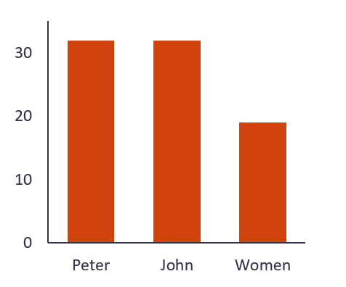
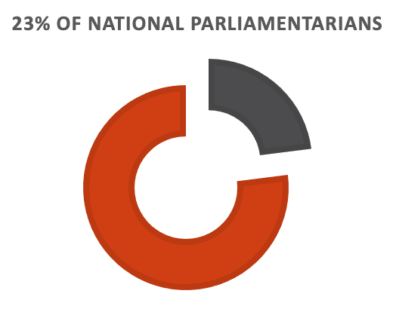
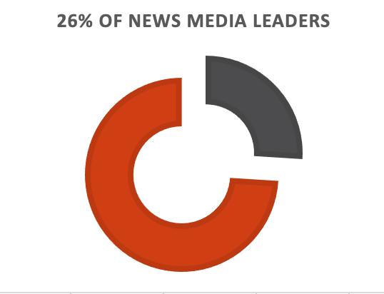
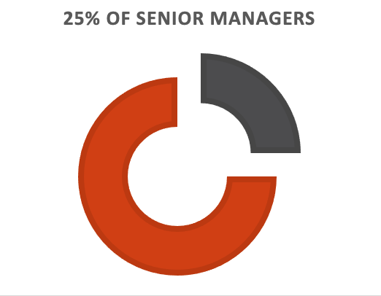

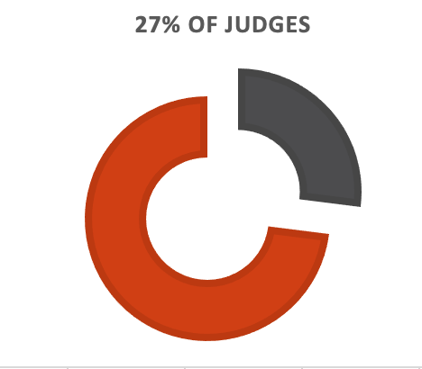
Men’s control of decision-making and limits to women’s independence
GLOBALLY WOMEN MAKE UP:
23%
26%
A CEO or company chair of an Australian business is more likely to be named Peter or John than to be a woman.
25%
15%
27%
1 in 7 Australians do not agree that women are as capable as men in politics and in the workplace.
1 in 4 Australians believe women prefer a man to be in charge of the relationship.
Notes:
Before you start:
You may want to incorporate images or photos of examples of men’s control of decision-making and limits to women’s independence in everyday life (for example, the proportion of women on boards).
Facilitator notes:
You may choose to show this slide to support – or instead of – the group reporting back with examples of what men’s control of decision-making and limits to women’s independence look like in both public life and in relationships.
Responses may include:
Expectation that the man in a heterosexual relationship is the primary earner, and should control decisions about spending, assets and bank accounts.
Men’s dominance of speaking time in class and both men and women interrupting women more frequently than they do men in meetings.
Men dominate leadership roles in organisations, even in female-dominated industries.
Underrepresentation of women in parliament and other positions of political representation. Female-dominated industries such as health and human services and education having significantly lower levels of pay than male-dominated industries and occupations.
Workplaces that fail to offer adequate flexible working arrangements for both women and men, such as part time roles, making it more difficult for families to decide caring arrangements.
Women’s portrayal in entertainment and the media through their relationship or connection to male protagonist, rather than as their own independent/multi-dimensional characters.
Sources:
Liveris 2017
Global Institute for Women’s Leadership 2021
Webster et al. 2017

Slide 19


Men disrespecting women to bond with each other
1 in 3 Australians believe it’s natural for a man to want to appear in control of his partner in front of his male friends.
Nearly 1 in 4 Australians believe there’s no harm in men making sexist jokes when they are among their male friends.
“This was locker room banter, a private conversation that took place many years ago.”
Donald J. Trump
Sources: Silva 2019; Davidson 2014; Webster et al., 2017
Notes:
Before you start:
You may want to incorporate images or photos of examples of men disrespecting women to bond (for example, recent media coverage).
Facilitator notes:
You may choose to show this slide to support – or instead of – the group reporting back with examples of what men disrespecting women to bond with other men looks like in daily life.
Responses may include:
Chants, hazing and initiation rituals that allow and promote abuse and disrespect towards women.
The norms that some things are OK to talk about in male peer groups, but not acceptable in ‘mixed company’, e.g. ‘locker room talk’.
Joking that someone only got the job as a ‘diversity hire’.
Women in male-dominated workplaces or industries are told to ‘man up’, be ‘one of the boys’ and expected not to get upset at sexist jokes or sexualised treatment.
Men telling degrading jokes about women or bragging about their sexual conquests as a way to bond with male peers, e.g. Australian Defence Force Skype scandal.
Boys and young men consuming and sharing images or video of women without their consent, e.g. Australian Defence Force Academy Skype scandal.
All-male sports commentary panels where degrading or demeaning talk about women is laughed off or ignored.
Online communities built on demeaning or humiliating women are allowed to remain active due to lack of enforceable standards to shut them down.
Sexualised objectification of women is used as a marketing strategy for sport or gaming.
If challenged about whether or not something is inappropriate, explain that no one is saying that people can’t make jokes but that jokes at the expense of others that perpetuates harmful stereotypes or treats people differently because of their characteristics (like gender, race, sexuality or disability) is tacitly supporting inequality.
Sources:
Davidson 2014
Silva 2019
Webster et al. 2017

Slide 20

Group activity: 10 minutes
In groups, participants to discuss one of the gendered drivers of violence against women and provide examples of this driver either in TAFE or the broader community.
Notes:
Timing: 10 mins + 3 mins feedback
Facilitator notes:
Display this slide when groups are brainstorming as a reminder of the question. If you are presenting this workshop online, post this slide in the chat function.
Participants will now spend 10 minutes brainstorming other examples of these drivers, either in TAFE or more broadly.
Divide participants into four groups and assign each group a driver. If delivering this workshop online, use breakout rooms
Allow 10 mins for group discussion
Bring the group back together and ask each group to share some of the examples they came up with (3 mins)

Slide 21
Taking action
Challenge condoning of violence against women
Challenge gender stereotypes and roles
Promote women’s independence and decision-making
Strengthen positive, equal and respectful relationships
Promote and normalise gender equality in public and private life
Address other forms of inequality and discrimination
Notes:
Timing: 2 mins
Facilitator notes:
Summarise the activity by explaining that actions that will prevent violence directly address the drivers:
Challenging the condoning of violence against women includes having TAFE policies and processes that show sexual harassment is taken seriously, raising awareness about the prevalence and impact of different forms of violence, and making sure TAFE communications about violence highlight the perpetrators’ responsibility rather than victims’ clothing or behaviour.
To address rigid gender stereotypes, we need to promote positive personal identities that are not restricted by stereotypes, and challenge gender roles. For example, using the arts and media to explore different male role models, providing unconscious bias training for people on recruitment panels, promoting flexible employment conditions for men, or encouraging women and girls’ participation in Trades and STEM.
To address men’s control in decision-making and limits to women’s independence, we must promote women’s independence and decision-making in public life and in their relationships. This means supporting women’s leadership in all its forms, and promoting alternatives to ‘how things have always been done’. For example, rolling out leadership training and mentoring programs for women, or promoting flexible work arrangements for both men and women.
To address men disrespecting women to bond, we must take action to strengthen positive, equal and respectful relationships. This can include bystander intervention programs to men and boys, and having policies that send a clear message that gender discrimination is not tolerated.
We need to address other forms of inequality and discrimination to prevent violence against women, such as racism, ableism, homophobia, transphobia, ageism, culture and religion.
Inform the participants you will move onto Topic 2 to explore what taking action looks like in a TAFE context.

Slide 22
Break: 10 minutes

Slide 23
2. FACE THE CHALLENGE
Learning outcomes:
Understand the relationship between gender equality and TAFEs
Explore primary prevention in a TAFE setting
Notes:
Topic 2 total time: 40 mins
Instructions:
This section will look at why TAFEs are a key setting for primary prevention, exploring the Respect and Equality in TAFE ‘whole-of-TAFE’ approach.
It will also unpack your specific role as senior leaders and taskforce members in promoting gender equality and preventing violence against women.
Facilitator note:
Reviewing the Respect and Equality in TAFE Guide will help you prepare for this section.
You should also tailor this section so that it is relevant to your TAFE, where you are at, and how you are approaching your work.

Slide 24
Why does violence against women occur?
Notes:
Timing: 7 mins
Key message: We have an evidence-base and shared framework that identifies what drives violence against women and the most effective approach to preventing it from occurring in the first place.
Instructions:
In recent years, lots of work has been done to collate and understand Australian and international research about why violence against women occurs, and what the most effective approach is to preventing it.
This has been important because it has helped to identify what really drives violence and to separate some of the more common misconceptions or excuses from what the research and data actually says.
By drawing together this evidence, it allows us to see patterns and correlations that happen across population groups and society as a whole – a whole-of-population approach – which helps us identify what things make a society or community more or less likely to experience violence against women.
A whole-of-population approach to prevention means that we are looking at what is happening for individuals, but also what is happening at the community level, in our workplaces, our TAFEs, the media, the arts, and all other aspect of society.
Reveal the first image: In Australia, this evidence has been collated into Change the Story, the national framework for preventing violence against women and their children.
This captures the international and Australian evidence that shows that there are four particular ways that gender inequality manifests that increase the likelihood of violence against women occurring. These are referred to as the ‘drivers’ and are what primary prevention work focusses on addressing.
Change the story also captures evidence on what an effective evidence-based primary prevention approach looks like – that is, what needs to be done to stop violence from occurring in the first place.
Reveal the second image – This means examining what social and cultural change needs to occur to create violence-free societies.
To do this, we need to identify and address how the drivers occur across all levels of society – the things we believe (norms), in what we say and do (practices), and the legislation, policy and institutions that shape and govern how we live (structures).
This approach isn’t new – it is similar to that taken by the drink driving or quit smoking campaigns. It means looking across all aspects of our society to identify what changes need to occur to stop the problem at its root drivers, then taking action across every level.
Facilitator notes:
Note that it is important to keep in mind that the drivers intersect with other forms of inequality like racism, ableism, ageism, classism, homophobia and transphobia. This means that we can be less likely to take seriously violence against some population groups of women, such as trans-women, or find it easier to justify putting limits on their independence, such as women with disability.

Slide 25
TAFEs as leaders
TAFEs influence people’s beliefs, attitudes and behaviours as places where people spend time studying, working, living and socialising.
As diverse and vibrant communities, TAFEs can ensure that more people are included in work to promote gender equality.
Every industry and sector has a role to play in challenging gender inequality, and TAFEs are uniquely positioned to help future workforces achieve this.
Notes:
Timing: 2 min
Key message: Preventing violence against women is more than just changing individuals, it's about changing the society and culture in which individuals develop their attitudes towards violence. This is why TAFEs have a vital role to play in reducing violence against women by actively promoting gender equality.
Facilitator notes:
Explain to the participants that every TAFE has a vital role to play in creating a society free from violence against women. TAFEs are uniquely positioned to help achieve this because they influence so many aspects of people’s lives, and are deeply embedded in their communities.
As workplaces, TAFEs can create an environment free of violence, where people are safe, respected, valued and treated as equals.
TAFEs can use their expertise and influence to inspire and promote gender equality amongst their student, industries, stakeholders and the broader community.
Instructions
Use the slide to summarise this activity, and move into the next section, unpacking the Respect and Equality in TAFE approach.

Slide 26
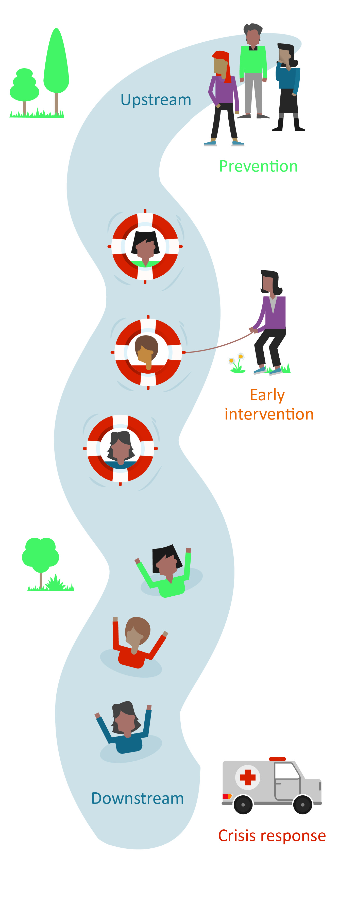
The relationship between primary prevention and other work to prevent violence against women
Primary prevention – whole of population initiatives that address the primary, underlying drivers of violence
Early intervention – aims to ‘change the trajectory’ for individuals at higher than average risk of perpetrating or experiencing violence.
Response services – supporting survivors and holding perpetrators to account (aims to prevent recurrence of violence)
Notes:
Timing: 7 mins
Key message: Preventing violence against women is more than just changing individuals, it's about changing the society and culture in which individuals develop their attitudes towards violence. This is why TAFEs have a vital role to play in reducing violence against women by actively promoting gender equality.
Facilitator notes:
Further explore the differences between primary prevention, early intervention and response services.
The whole-of-TAFE approach is about primary prevention.
It takes a whole of population approach to prevent violence before it occurs and to change and transform the social context in which violence occurs.
Primary prevention sits alongside other work to address violence against women. Secondary (early intervention) and tertiary prevention (response) focus on providing information and services to people experiencing, or at risk of experiencing, violence. While essential, early intervention and response are unlikely to significantly reduce rates of violence on their own.
The primary prevention model is used as an approach to address public health problems issues, for example smoking, seatbelts and skin cancer.
Primary prevention is a much longer-term goal than response and early intervention actions to address violence against women and it is the approach that will have the largest impact on ending violence against women.
What we know
Violence against women is a complex social problem, but one that can be prevented
No single cause of violence against women, but evidence shows violence against women is more likely to occur when gender inequality is ingrained in social, cultural and organisational structures and practices
An intersectional approach to prevention acknowledges that while gender inequality is a necessary condition for violence against women, it is not the only or necessarily the most prominent factor in every context because violence against women is often experienced in combination with other forms of structural inequality and discrimination. (eg. Racism, colonization and dispossession, discrimination against people with disabilities and discrimination on the basis of sexuality or gender identity).
As we’ve seen with other major social changes, such as smoking and seatbelts, we need leadership and change across legislation, policy, government, communities and individuals

Slide 27
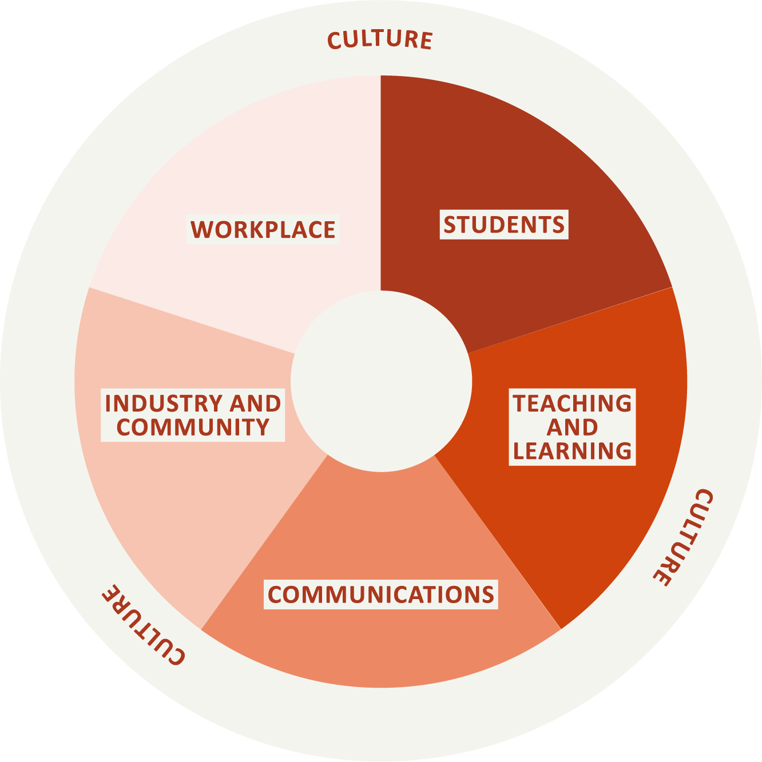
Respect and Equality in TAFE: whole-of-TAFE model
A whole-of-TAFE approach will include planned and coordinated actions across these five domains:
Workplace
Students
Teaching and learning
Communications
Industry and community
Notes:
Timing: 4 mins
Key messages: A ‘whole-of-TAFE approach’ requires working across the five domains that engage every part of the TAFE culture and community.
Additional information:
Research and evidence tells us that violence against women can be reduced by increasing gender equality in everyday life. By engaging with Respect and Equality in TAFE, your TAFE can help prevent violence against women, and build a culture where gender stereotypes are challenged, gender-based discrimination is unacceptable, and gender equality is actively promoted and modelled.
Across our society, if we all work together, as educators, as employers and as a community, then we can change this picture of gender inequality in Australia and stop violence against women before it starts. Achieving the vision of an Australia free from violence, means every TAFE has a role to play.
Respect and Equality in TAFE focuses on both organisational responsibilities (such as leadership and governance) and individual responsibilities (such as teaching and learning practices).
Facilitator note:
Revisiting the Respect and Equality in TAFE Guide will help you prepare to deliver this slide.
Tailor this slide so that it is relevant to your TAFE. Make a note of any work that has already begun across any of these domains.

Slide 28
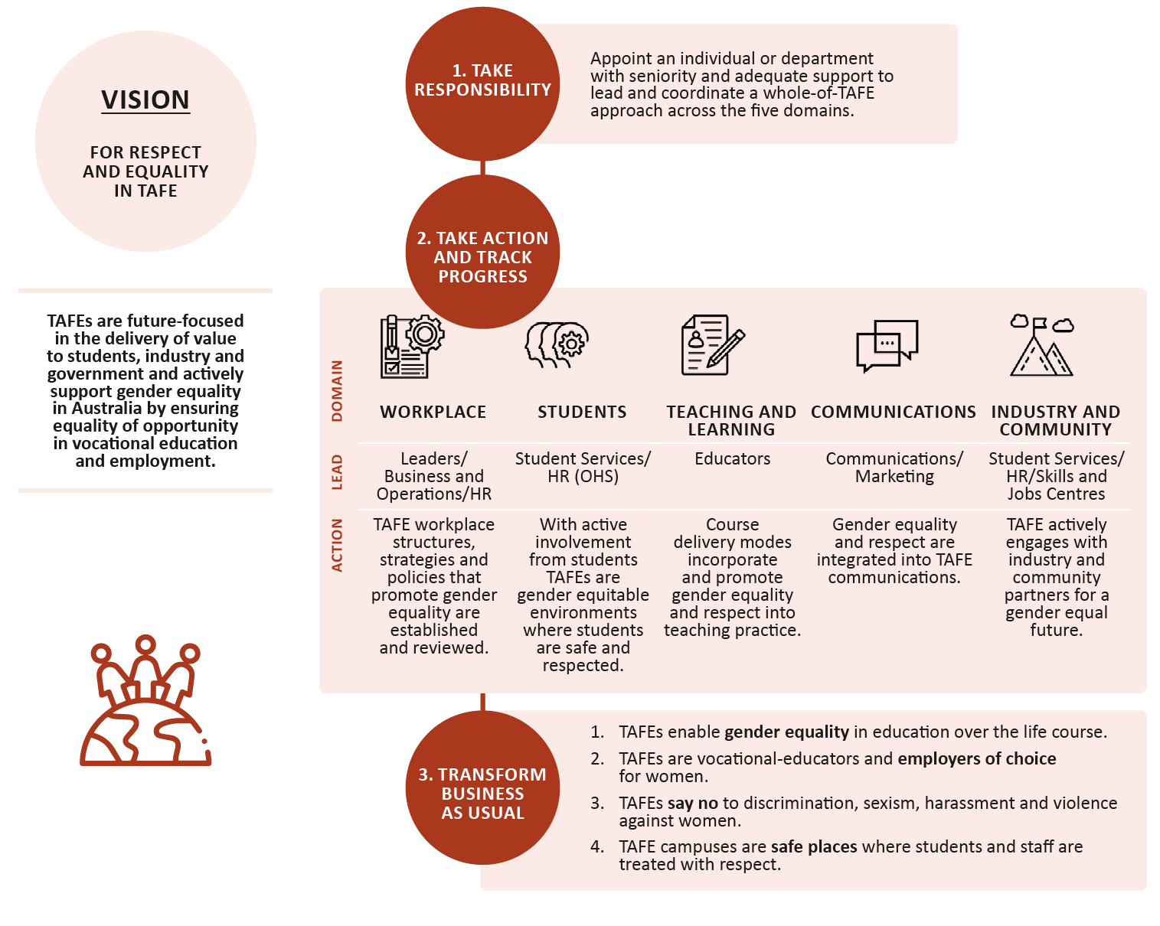
Bringing it all together
Across our society, if we all work together, as educators as employers and as a community, we can change this picture of gender inequality and stop violence against women before it starts. In achieving the vision of a Australia free from violence, every TAFE has a role to play.
Notes:
Timing: 10 mins
Key messages: An effective whole-of-TAFE approach requires focusing on all aspects of how a TAFE operates, in order to build a culture among staff and students where gender equality is promoted and modelled.
Instructions:
Use the diagram and the additional information below to talk through the key elements of the approach. You will go into more detail in the forthcoming slides. The slide reads from the bottom upwards so start with ‘take responsibility’.
Additional information:
Respect and Equality in TAFE Guide outlines an approach that supports and builds environments where staff and students feel safe, respected and valued.
Respect and Equality in TAFE Guide outlines a ‘whole-of TAFE-approach’ that recognises the need for a range of actions that everyone in TAFE engages with, from CEOs and senior executives, to managers, human resources staff, educators, student services staff and students. These actions are designed to stop violence against women before it occurs, which is called a primary prevention approach.
Respect and Equality in TAFE approach has been designed specifically to support TAFE leaders as well as those driving prevention activity within TAFEs. The approach aims to support the staff or departments who are assigned to leading the gender equality work.
Primary prevention work in TAFEs involves a continuum of interlinked activities where prevention actions are integrated with early intervention and family violence response services. Respect and Equality in TAFE recognises that for primary prevention activities to be delivered safely, appropriate response policies, procedures and services must be in place. It is important for response systems and referral pathways to family violence and sexual assault services are established before action to prevent violence is undertaken.
Facilitator note:
Revisiting the Respect and Equality in TAFE Guide will help you prepare to deliver this slide.

Slide 29



Levers
Values and expected behaviours
Structures and policies
Culture and norms
Notes:
Timing: 10 mins
Facilitator notes:
Explain to participants that actions in one area alone will not bring about change; multiple strategies operating across the 5 domains will complement and reinforce each other.
Describe each of the levers, and ask participants for examples of how the TAFE can create change across each of the three levers:
A TAFE’s values frame how it sees itself and how others see the TAFE. They are used to highlight a TAFE’s distinct focus, culture or relationship to community and industry. When the values are authentic and reinforced in communications, values can resonate deeply with staff and students. Possible examples include:
explicitly addressing gender equality and respect in the TAFE’s values
setting and modelling expected behaviours so that sexism, harassment and violence are never acceptable
linking values to formal staff performance reviews.
Structures and policies are about TAFE’s institutional governance, and how these contribute to the distribution of power and resources between people of different genders. Possible examples of structural and policy change include:
reviewing structures to ensure that they provide equal opportunities and support the independence and leadership of all women and gender diverse people
ensuring policies and procedures are inclusive of all women and gender diverse people, including people with disability, migrant and refugee people, Aboriginal and Torres Strait Islander people, and people from diverse cultural backgrounds
developing primary prevention plans and measuring and reporting on progress.
Cultures and norms are about the actual and assumed ‘rules’ of behaviour within a given community. These shape expectations about appropriate behaviours among TAFE staff and students, and in turn the actual behaviours of individuals within the TAFE. TAFE can influence culture and norms by:
ensuring the norms contribute to a culture of respect for everyone, regardless of gender, sexuality, race, religion, cultural background and disability
creating a culture that recognises and celebrates the contribution and achievement of women and gender diverse people.
Inform the participants that they will now look at what you can do as senior leaders and taskforce members.

Slide 30
3. OWN THE CHALLENGE
Learning outcome:
Understand your role as leaders in creating an enabling environment and driving change
Notes:
Topic 3: Own the challenge
Total timing: 50 mins
Timing: 1 min
Instructions:
This final section will focus on what you can do as leaders and taskforce members. It will draw on the knowledge and expertise in the room to come up with some practical actions that senior leaders and taskforce members can start to take to drive positive change.
Facilitator notes:
Inform participants that this final section will explore how senior leaders and taskforce members can drive positive change, and create an enabling environment for work to prevent violence against women and promote gender equality.
You are encouraged to tailor this section to your TAFE’s circumstances.

Slide 31
A leadership issue
A commitment from senior leaders to act on gender equality across all five domains of the TAFE is the first and most important step in driving change.
Leaders can:
  Role model respect and equality
  Make a formal commitment
  Allocate resources
  Support staff
Notes:
Timing: 3 mins
Facilitator notes:
Explain to participants :
The success of the whole-of-TAFE approach relies on formal support from TAFE leadership:
Leaders shape what is expected, accepted, and applauded in your TAFE, and leaders can actively and consciously support and model gender equality and respect to prevent violence against women.
Formal commitment and support creates a strong impetus for action. The right authorising environment focuses efforts, provides legitimacy to the work, encourages engagement and buy-in from others, and gives permission to keep driving and holding others to account when challenges arise. It allows the taskforce to approach educators about participating in professional development, Human Resources about reviewing policies, and communications staff about promoting gender equality through their work.
Commitment is also about resourcing and responsibility, including making sure that the taskforce have the knowledge and support they need.
Ultimately, the safety and wellbeing of the TAFE community is a leadership issue, and change must start at the top. Developing a public leadership statement and/or committing to developing a strategy or action plan on gender equality is a great way to establish and communicate this commitment. In Victoria the Commission for Gender Equality states the Gender Equality Act Plan should include ‘a statement which explicitly sets out your… commitment to the gender equality principles outlined in section 6 of the Act’.

Slide 32
What can you do as a leader?
  Create and fund a lead position to drive this work.
  Allocate resources towards each area of the university participating in this work.
  Put out a public statement committing your TAFE to action on gender equality.
  Undertake a review of internal policies and procedures for responding to complaints of violence against women on and off campus.
  Examine how the TAFE supports victims of violence in leave provisions.
  Undertake a review of recruitment, remuneration and promotion practices within the TAFE with a gender lens.
Notes:
Timing: 10 min
Facilitator notes:
Using this slide as a starting point, ask participants to brainstorm ideas and actions for how TAFE leadership can drive and progress this work. Make note of any other ideas and challenges offered by participants.

Slide 33
What will you commit to?
1
2
3
Short term
Within 12 months
Medium term
Next 2–3 years
Long term
Beyond 3 years
Notes:
Timing: 10 mins
Facilitator notes:
Encourage the group to commit to at least one action – with the group’s support – in the short, medium and long term. Document this decision, and identify the next steps for implementation.

Slide 34
Opportunities to take action
What opportunities are there to enhance your TAFE’s capacity to prevent violence against women?
What is one action you can take in your everyday life to promote gender equality?
Notes:
Timing: 25 mins
Brainstorming session:
Ask participants to break into pairs and brainstorm areas that could be addressed (in any domain) to prevent violence against women and promote gender equality. Ask them to identify one action they personally can take in their everyday lives to promote gender equality. Allow 10 minutes for brainstorming and 15 minutes to report back to the group.
Possible responses may include:
Student life
Support extra-curricular activities to role model equality and respect.
Improve access to respectful relationships education and bystander training for students.
Promote LGBTIQ+ inclusive and responsive campus services.
Teaching and learning
Support educators to apply a gender lens to course content, considering what is being taught, and by whom; who is positioned as experts; and representation on course reading lists.
Consider the gender composition across different courses and units.
Improve access to resources and training about violence against women for sessional and casual staff.
Workplace
Consider gender composition across different departments.
Improve representation of women and LGBTIQ+ people in senior roles.
Increase uptake by and normalise men taking parental leave and flexible work arrangements.
Communications
Consider how you promote gender equality in social media.
Consider whether gender bias is present in promotion of course materials.
Examine marketing and communications for gender and other stereotypes.
Industry and Community
Improve campus facilities so they are safe, equitable and accessible to all students.
Explore industry partnerships that role model respect and equality.

Slide 35
In conclusion
Understand the challenge
Face the challenge
Own the challenge
Take action and monitor progress
Transform business as usual
Workplace
Students
Teaching and learning
Communications
Industry and community
Notes:
Timing: 1 minutes
Facilitator notes:
Summarise the workshop with a focus on:
Violence against women is driven by gender inequality and the four drivers of violence against women.
The whole-of-TAFE framework and the five domains.
Actions identified in the workshop and commitment to implementation.

Slide 36
Thank you
Don't forget to access support if you need to:
1800RESPECT (1800 737 732) or your TAFE supports
Notes:
Timing: 1 min

Slide 37
Closing slide

