Slide 1
INFORMATION FOR TEACHING ACADEMICS
INFORMATION FOR TEACHING ACADEMICS
These slides are designed to provide content to support the facilitation of teaching resources about the prevention of gender-based violence in and through health settings.
It is necessary to spend some time developing understanding around the threshold concepts that students need in order to approach material related to gender equality and gender-based violence, so that it informs their way of thinking and knowing. The table at the right indicates the threshold concepts that underpin prevention of gender-based violence and the relevant topics and pages within this slide deck that unpack these concepts.
The Educators’ guide to upskilling pre-service professionals to support the prevention of gender-based violence contains additional information to support academics to integrate prevention of gender-based violence into their teaching content and practice.
Threshold concept | Corresponding content from this slide deck
The social construction of gender | Topic 1, pages 9-11
The socio-ecology of gender norms, practices and structures | Topic 2, pages 17-19
Privilege, oppression and intersectionality | Topic 2, pages 15-16 Topic 3, pages 23-25 Topic 4, page 44
The gendered drivers of violence against women | Topic 4, pages 27-44
Notes:
Facilitator notes
This slide aims to give an overview of how the content in this slide can support teaching about the threshold concepts related to the primary prevention of gender-based violence. These need to be embedded across the life of a program to ensure basic levels of understanding are established in primary education graduates.
For further information about upskilling students in your university about the prevention of gender-based violence, refer to https://handbook.ourwatch.org.au/leadership-resource/upskilling-pre-service-professionals-to-support-the-prevention-of-gender-based-violence-an-overview

Slide 2

PREVENTION OF GENDER-BASED VIOLENCE IN AND THROUGH CRIMINOLOGY
Understanding how criminal justice systems and settings can work to address gender inequality and prevent gender-based violence
Notes:
Before the training:
You may want to include your university’s branding on these slides.
Note that Our Watch has endeavoured to ensure that the information contained in this training is correct and current at the time of publication. It is at the discretion of the user to deliver the training as outlined and no responsibility is taken by Our Watch if content is altered or omitted.
All information is current as at November 2021.

Slide 3
ACKNOWLEDGEMENT OF COUNTRY
We acknowledge the traditional custodians of the land on which we meet, who have never ceded their sovereignty – and pay our respects to Elders past, present and future as well as acknowledge any Aboriginal and Torres Strait Islander people who may be joining us today.
We acknowledge the decades-long work and advocacy of Aboriginal and Torres Strait Islander people in working to prevent and address violence against women and LGBTIQ+ people.

Slide 4
CHALLENGING CONTENT
Gendered discrimination and violence is common. We can be almost certain that the issues we are raising will be directly relevant to some of the people in this room. Because of this, some people might find the content confronting or triggering. If you need to take a break, please do so.
While we acknowledge and support you, this is not the place to reveal sensitive personal information. If you want to seek more help,
please see the resources listed on the next slide.
Violence against women is not a women’s issue.
It is an important social issue and men and women can and should play a positive role to prevent it. Most men are not violent. If you are not a violent man, we are not talking about you when we discuss perpetrators of violence.
Even if none of this applies to you, please be mindful about others, and take care to
discuss and debate the issues with respect and consideration for your classmates.
Notes:
Facilitator notes:
Inform participants that this training will cover information about gender-based violence, and can be personally challenging.
frame the discussion in relation to the facts and evidence base, and invite students to ask questions to unpack any uncertainties throughout the session.
Reiterate throughout the relevance of this content to the students’ discipline and to their future professional lives.
Let participants know that internal and external support services are available if they, or anyone they know, needs support during or after the training. Use the next slide to communicate referral information.

Slide 5
SUPPORT SERVICES
1800RESPECT
1800 737 732
24/7 support for people impacted by sexual assault, domestic violence and abuse.
MensLine Australia
1300 789 978
24/7 counseling for men with emotional health and relationship concerns.
Men’s Referral Service
1300 766 491
Telephone counseling, information and referral service for men using violent or controlling behaviour.
1800respect.org.au
mensline.org.au
service name
xxx xxx xxx
Input state or university- specific services.
service name
xxx xxx xxx
Input state or university- specific services.
service name
xxx xxx xxx
Input state or university- specific services.
website
website
website
Notes:
Before the training:
It is recommended you include the details of your university’s student support services, and processes for handling disclosures of violence and harassment. You may choose to put these on screen or develop a handout.
You may want to include appropriate state-based support services. Support directories for state-based services can be found at familyviolencelaw.gov.au/get-help or anrows.org.au/support-directory. Consider including support services for Aboriginal and Torres Strait Islander people, LGBTIQ+ communities and multicultural communities.

Slide 6
TOPICS OVERVIEW
TOPIC 1
Understanding gender and sexual identity
TOPIC 2
Understanding gender-based systems
TOPIC 3
Intersectionality and gender equity
TOPIC 4
Addressing gender-based violence
TOPIC 5
Dealing with resistance to gender equity

Slide 7
TOPIC 1
UNDERSTANDING GENDER AND SEXUAL IDENTITY
Learning Outcome
Understand gender as a social construct and a social determinant of health. Understand gender and sexual identity as fluid and diverse.

Slide 8
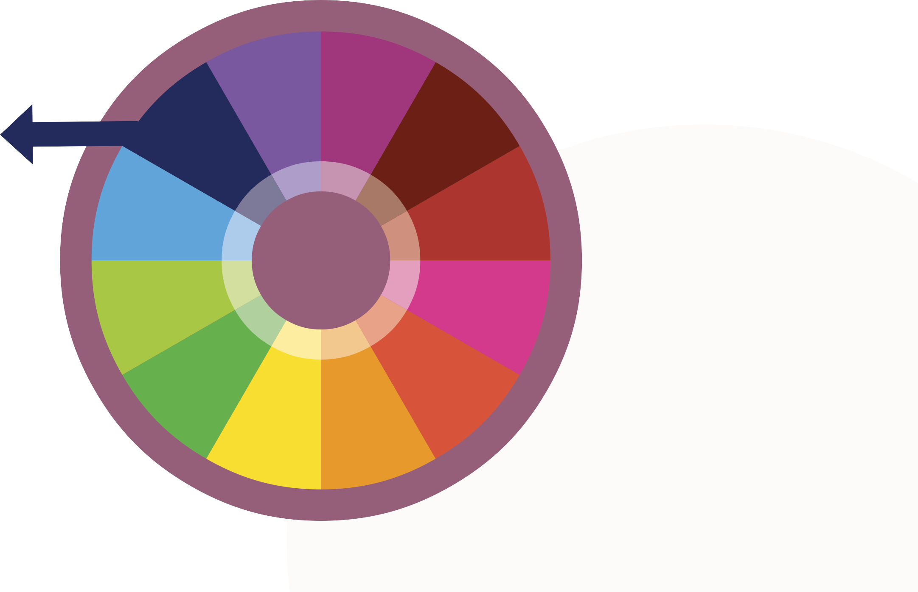
GENDER AS A SOCIAL DETERMINANT OF HEALTH
Health
Services
Employment/ Working Conditions
Gender
as a Social Determinant of Health
Education and Literacy
Gender
Financial and
Social Status
Physical Environments
CORE DETERMINANTS OF HEALTH
Social Support Networks
Culture
Biology and Genetic Environment
Personal Health Practices and Coping Skills
Healthy Child Development
Social
Environments
Notes:
Facilitator notes
Social determinants of health, sometimes referred to as the ‘core determinants’, are the conditions in which people are born, live, grow, work and age that influence their health outcomes. Examples include:
gender
Education and literacy
employment
culture
financial and social status
physical environment (including housing)
social environment.
These determinants often interact and influence each other, meaning that a person’s gender, education and other conditions have considerable influence in shaping their experience of the world and the expectations, opportunities and barriers.
Social determinants of health, sometimes referred to as the ‘core determinants’, are the conditions in which people are born, live, grow, work and age that influence their health outcomes.
The Madrid Statement issued by the WHO in 2002 recognises that the factors that determine health and ill health are different for men and women. It argues that mainstreaming gender in health is the most effective strategy for achieving gender equity. Such a strategy, if comprehensively implemented, would promote the integration of gender concerns into the development and monitoring of policies and services with the aim of ensuring that women and men achieve optimal health outcomes.
Sources
Department of Health | 5.1 Sex and gender as determinants of health

Slide 9

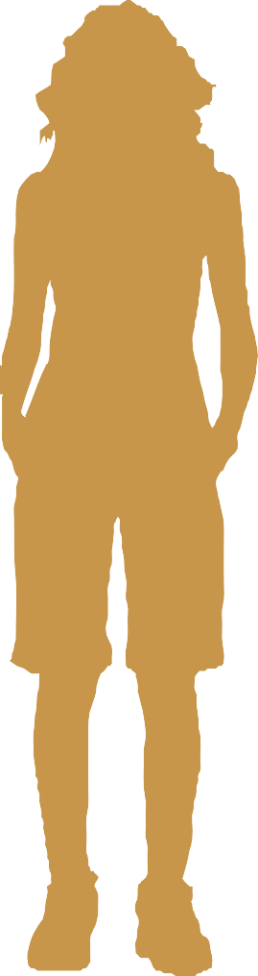
GENDER AND SEX EXPECTATIONS
BINARY EXPECTATIONS
Sex
Assigned at birth as either male or female.
Gender identity
Either man or woman.
Sexuality
Attracted to the opposite ‘sex’.
Male
Man
Attracted to women
Female
Woman
Attracted to men
Notes:
Facilitator notes:
Historically in our society, sex and gender have operated in a binary of opposites and either/or – male/female, man/woman
We are assigned a sex at birth (or before) and from that our gender AND our sexuality is often implied.
This is a very rigid perspective of gender that fixes it to our sex and our sexuality, with origins in our institutions such as medicine, religion, government and family.
Sex assigned at birth
Sex refers to a person’s biology, such as the physical characteristics of their genitalia, their chromones, their hormones and whether they produce sperm or eggs. People are assigned a sex at birth.
Even at a biological level there are strong messages in our society telling us that we must have bodies that fit into either male or female.
While many of us do fit into the box of being either clearly defined male or female, there are also many people born with physical sex characteristics that don’t fit medical and social norms for female or male. These people are referred to as intersex.
Intersex people
From birth, many intersex people experience a medical community and society telling them their bodies are wrong and need to fit within only male or female, and their sex is assigned based on the appearance of genitals. The Australian Human Rights Commission estimates that 1.7 percent of children born in Australia are intersex, however this may be a conservative estimate “given that many elements of sex are difficult to detect”. See Intersex Human Rights Australia for further information if needed: https://ihra.org.au/
Gender
Gender refers to the socially learnt roles, behaviours activities and attributes that society considers appropriate for men and women. Gender varies between cultures and changes over time.
Historical and societal understanding and expectations of gender define masculinity and femininity. People are expected to identify as either a man or a woman – and this is expected to match their genitals and chromosomes.
Norms (or society-wide beliefs) about gender mean that people who identify as a man are expected to wear certain clothes (and not others), enjoy certain things, or express themselves in particular ways – and this looks very different for people who identify as a woman.
Prompts
Ask students to think about the traits commonly associated with ‘being a man’ or ‘being a woman’ i.e. masculinity and femininity.
Look for ways these can be grouped in sex-based or biological characteristics, and gender-based or socially constructed characteristics.

Slide 10

GENDER CONSTRUCTION IN ACTION
Girl toys vs boy toys: The experiment | BBC Stories
Notes:
Facilitator notes:
This video reinforces the understanding that gender is constructed and reconstructed by different environmental forces starting when a child is born (or even before where the sex of the child is known or anticipated).
Summarise gender
The socially constructed characteristics of women and men
Includes norms, roles and relationships of and between groups of women and men
Varies from society to society therefore it means different things in different places (e.g. in some cultures traditional male dress can look like a skirt or dress)
Varies across time (e.g. once it was unacceptable in Australia for women to go out alone or without a male chaperone)
Given that it is fluid and dynamic across place and time, it can therefore be changed.
Watch
“Girl toys vs boy toys: The experiment” by BBC Stories - 3.25min
https://www.youtube.com/watch?v=nWu44AqF0iI
Prompts
Ask students to think about the traits commonly associated with ‘being a man’ or ‘being a woman’ i.e. masculinity and femininity. Record these on a flip/chart or digital whiteboard.

Slide 11
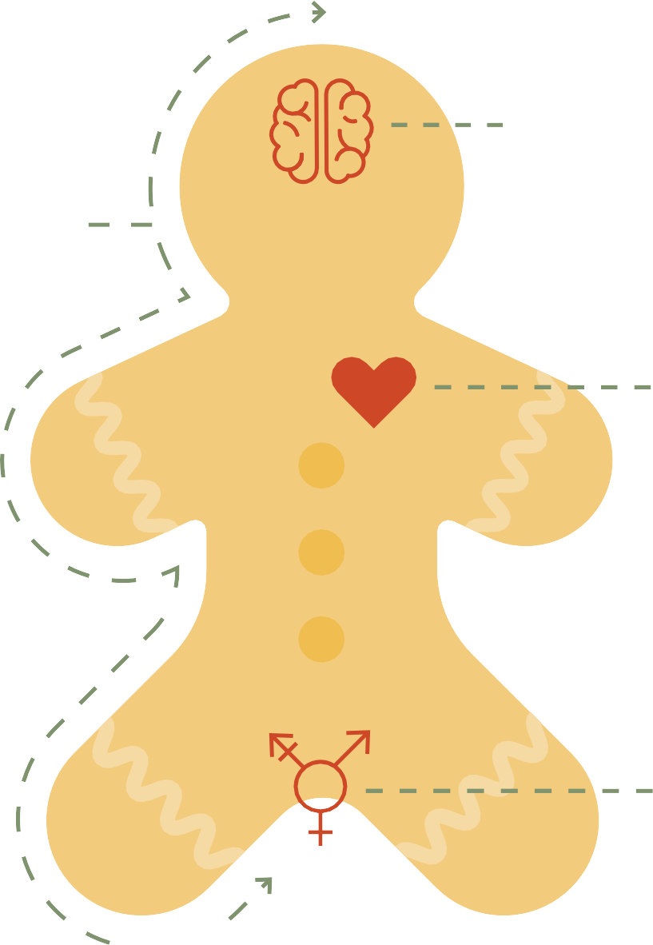

THE GENDERBREAD PERSON
Gender Identity
Identity
Woman-ness Man-ness
Expression
Gender Expression
Attraction
Feminine
Masculine
Biological Sex
Female-ness Male-ness
Sex
Sexually/Romantically Attracted to
Women/Females/Femininity Men/Males/Masculinity
Notes:
Facilitator notes:
Features of our gender identity and sexuality are actually open, diverse, varied and even fluid, despite historical and current social expectations.
Explain the difference between gender identity and gender expression:
Gender identity is how a person thinks of their own gender. This may align with the sex they were assigned at birth (i.e. cisgender) or it may not (i.e. transgender or non-binary). E.g. do you think you fit better into the societal role of “woman” or “man,” or does neither ring particularly true for you?
Gender expression relates to the way a person presents their gender, through clothing, appearance, behaviours, language etc and how those presentations are interpreted by others based on social gender norms.
Gender expression is interpreted by others based on traditional gender norms (e.g., men wear pants; women wear dresses). Gender expression is something that often changes from day to day, outfit to outfit, and setting to setting. Your gender expression may or may not align with traditional ways of expressing gender, and can be motivated by your gender identity, sexuality, or something else completely (e.g., just for fun, or performance). It may not even align with your gender identity. For example, a persona who is assigned female at birth, and expressed their gender as a girl due to social and family expectations, may identify as a male as they grow up, but continue to express their gender as a female due to ongoing social pressures and fears of not “fitting in”.
Ask students if there are any additional terms they do not understand. Refer to next slides for definitions of related terms.
Source: Breaking through the Binary - by Sam Killermann (genderbread.org)

Slide 12
LGBTIQ+ NAMING SEXUALITY AND GENDER
LESBIAN
BISEXUAL / BI
QUEER
A woman who has a romantic and/or sexual orientation toward women. Some non-binary people also identify with this term.
A person who experiences sexual, romantic, physical, and/or spiritual attraction to more than one gender, not necessarily in the same way, or to the same degree.
A multi-faceted word that is used in different ways and means different things to different people.
Attraction to people of many genders.
Don’t conform to cultural norms around gender and/or sexuality.
A general term referring to all non-heterosexual people.
GAY
Used to refer to men who are attracted to men in a romantic, erotic and/or emotional sense. Not all men who engage in same- gender sexual behaviour identify as gay.
TRANSGENDER
A person whose sense of personal identity or gender does not correspond to the sex they were assigned at birth or does not conform to gender stereotypes.
Some within the community, however, may feel the word has been hatefully used against them for too long and are reluctant to embrace it.
Notes:
Facilitator notes
Use these slides to clarify understanding of different terms related to gender and sexual diversity.
Draw attention to the fact that in Australia the Q is sometimes left out. This is because Queer was historically used as a term of abuse – a derogatory word for people who were not heterosexual.
There are still people who define themselves as Gay or Lesbian who do not want to call themselves Queer. There are other people who have embraced the word Queer and who see it as a non-conformist lens on the world and a life-style, rather than simply relating to sexual identity.
Often people who identify as Queer have sexual and romantic partners of all genders.
Prompts
Ask class to define acronym LGBTIQ.
Watch
Refer to this video for a detailed explanation of the terms and related concepts
LGBT 101: An introduction to the Queer community (7 mins) https://www.youtube.com/watch?v=DE7bKmOXY3w&t=14s&ab_channel=MargalitSchindlerMargalitSchindler
Resources
The following article describes how ‘lesbian’ can feel limited for some, who prefer the fluidity offered by Queer
https://slate.com/human-interest/2016/12/young-queer-women-dont-like-lesbian-as-a-name-heres-why.html
“The word lesbian, insofar as it means a woman who is primarily attracted to women, does not correctly describe our reality. My personal queer community comprises cisgender and transgender women; transgender men and transmasculine people; and people who identify as non-binary or genderqueer. One friend told me queer works better for her and her female spouse because lesbian implies a kind of sameness she doesn’t see in her relationship or those of her peers.”

Slide 13
LGBTIQ+ NAMING SEXUALITY AND GENDER CONT.
QUESTIONING
INTERSEX
GENDERFLUID
An individual who is unsure of and/or exploring their gender identity and/or sexual orientation.
An umbrella term that describes people born with any of 30
different variations in sex characteristics including chromosomes, gonads, sex hormones, or genitals.
A person who does not identify with the gender binary and moves within genders and gender stereotypes.
ASEXUAL
A person who experiences little or no sexual attraction to others and/or a lack
of interest in sexual relationships/behaviour. They may or may not experience emotional, physical, or romantic attraction. Asexuality differs from celibacy in that it is a sexual orientation, not a choice.
GENDERQUEER
A person who does not identify or express their gender within the gender binary. Those who identify as genderqueer may identify as neither men nor women, may see themselves as outside of or in between the gender binary, or may simply feel restricted by gender labels.
PANSEXUAL
A person who experiences sexual, romantic, physical, and/or spiritual attraction for members of all gender identities/expressions.
NON-BINARY / ENBY
A person whose gender identity does not fall within the binary genders of man or woman.

Slide 14
TOPIC 2
UNDERSTANDING GENDER-BASED SYSTEMS
Learning Outcome
Identify patriarchy as the underpinning system of power that creates gender inequality. Understand that norms, practices and structures operate at all levels of the socio-ecological model, which influence gender equality.

Slide 15
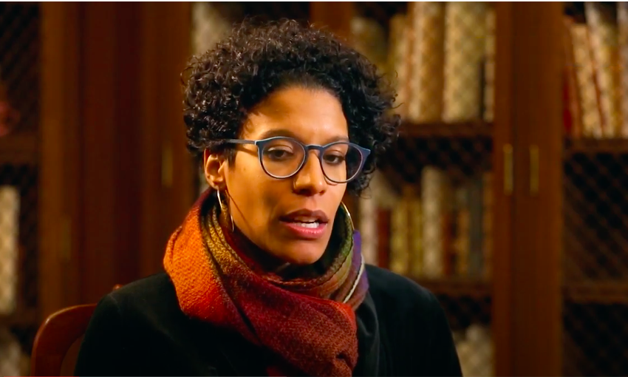
PATRIARCHY AND GENDER
Patriarchy is a social system in which men hold primary power across roles of political leadership, moral authority, social privilege and control of property.
Patriarchy is associated with a set of ideas that acts to explain and justify this dominance and attribute it to ‘natural’ differences between men and women. Historically, patriarchy has manifested itself in the social, legal, political, religious, and economic organisation of a range of different cultures.
Emily Owens at Brown University explains the concept
Notes:
Facilitator notes
Let class know that it is important to understanding gender – as a social system of power, privilege and oppression, patriarchy expects and values particular gendered attributes in women and men (as well as gender diverse people).
It’s important to emphasise that although men are privileged by the patriarchy, it is a system that also limits men – for example via rigid gender roles and expectations around acceptable ways to be a man. Note that this differs between countries and cultures., which is why we know that gender and it’s embedded concepts of masculinity and femininity are socially constructed.
‘This is a culture that teaches us that gender inequality doesn’t exist, or if there are inequalities, then they are deserved, biologically ordained or just and fair,’ Michal Flood, VicHealth
Prompts
Ask class if they are familiar with the term ‘patriarchy’ and what they understand by it.
Watch
What is patriarchy?(2:37)
https://www.youtube.com/watch?v=R0LXAC2PXuU&ab_channel=ChoicesProgram
Sources/resources
https://www.vichealth.vic.gov.au/-/media/ResourceCentre/PublicationsandResources/PVAW/Encountering-Resistance-Gender-Equality.pdf

Slide 16
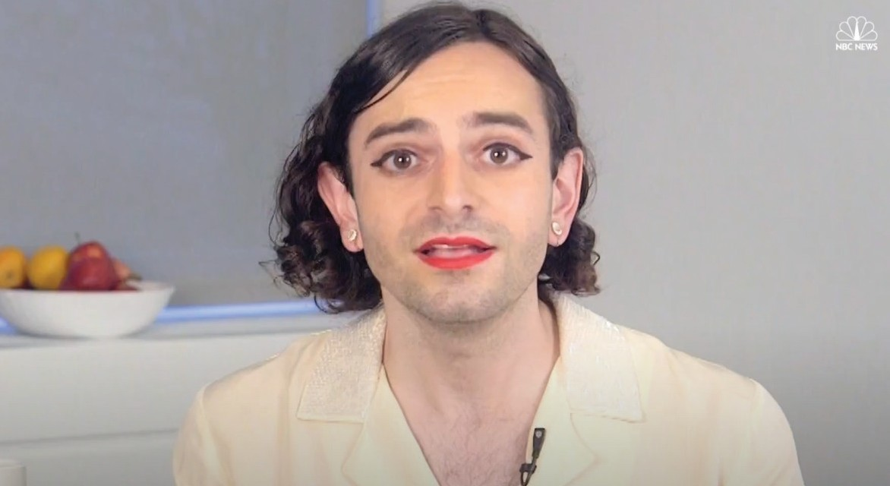
HETERONORMATIVITY AND CISNORMATIVITY
Heteronormativity is the assumption that everyone is heterosexual. This manifests in explicit questions, behaviours, traditions and laws which are heterosexist.
Cisnormativity is the assumption that everyone’s gender identity matches the sex they were assigned at birth.
The Problem With Heteronormativity | Queer 2.0 | NBC Out
Notes:
Facilitator notes
Heteronormativity and cisnormativity are also systems of power, privilege and oppression that expect and value particular attributes of people based on their sexuality and gender identity. They support the binary notions of gender/sex/sexuality being aligned and rigid, as shown on slide 9.
Rigid gender norms are reinforced by the idea that the only ‘normal’ and ‘natural’ bodies and gender identities are ‘male’ and ‘female’. The binary gender norms that drive violence against women are therefore inherently linked to the cisnormativity that drives violence against trans and gender diverse people, and motivates medical interventions aimed at ‘normalising’ intersex bodies.
We live in a heterosexist society. In the most basic terms this means that there is a deep-rooted belief and assumption that everyone is heterosexual and anyone who is not is not normal. Heterosexism is any attitude, action, or practice backed by an institutional power that subordinates people because of their sexual orientation. Remind students that it wasn’t until Dec. 7, 2017, that the Australian Parliament passed legislation allowing gay and lesbian couples to legally wed. And it was only in 1975 that homosexuality was decriminalized in South Australia – everywhere else in Aust it was a criminal offence.
Prompts
Ask students to think of ways that heterosexual people are privileged in society
Refer to the queer ally homework pdf if necessary to get some ideas for the discussion on the way heterosexual people are privileged. Ask students to come up with some more. http://queer.ucmerced.edu/sites/queer.ucmerced.edu/files/page/documents/queer_ally_homework.pdf
Sources/resources
https://www.abc.net.au/news/2015-08-24/timeline:-australian-states-decriminalise-male-homosexuality/6719702?nw=0)
https://www.hrc.org/resources/marriage-equality-around-the-world
https://en.wikipedia.org/wiki/Timeline_of_same-sex_marriage
Judith Butler's Theory of Gender Performativity, Explained - https://www.youtube.com/watch?v=0XFg8f1STLk&ab_channel=MediaStudieswithJordanSchonigMediaStudieswithJordanSchonig
Rainbow Health Victoria | Pride in Prevention Evidence Guide

Slide 17

GENDER NORMS, PRACTICES AND STRUCTURES
Norms
Beliefs Attitudes Values Stereotype
These elements can influence:
People’s general health and wellbeing.
How health services respond to the needs of patients and clients.
How people access health services.
Structures
Policies Laws Systems Hierarchies
Practices
Behaviours Actions Processes
Notes:
Facilitator notes
Gender manifests through norms, practices and structures. These are the building blocks of gender and when they are unequal, inequitable or harmful, they can lead to gender unequal outcomes for women, men and gender diverse people.
Norms: the things which represent our knowledge about what other people do and what we think we should do, such as the belief that, because of biology, women are ‘naturally’ best suited to care for children.
Practices: the ways these norms are usually or habitually performed, such as differences in childrearing practices for boys and girls.
Structures: systems such as organisations, policies or rules that arrange our norms and practices in particular ways, such as the gender pay gap or differences in access to parental leave.
For example:
The belief in our society that women should be the primary caregivers for children (norm) means there is an expectation that they will do a majority of the caregiving tasks (practice), resulting in gestating parents, mothers, having access to the majority of paid and unpaid parental leave (structure). This, in turn, reinforces the norm and practice that women are responsible for childrearing and perpetuates norms, practices and structures that work against men performing this role (including men who are the primary carer and men in same-sex relationships).
Summary: Norms, practices and structures interact and reinforce each other, and have a cumulative impact over time, profoundly influencing outcomes for women, men and gender diverse people across the life course. Where these different outcomes equate to disadvantage or harm for one group over another it is described as gender inequality (see next slide).

Slide 18


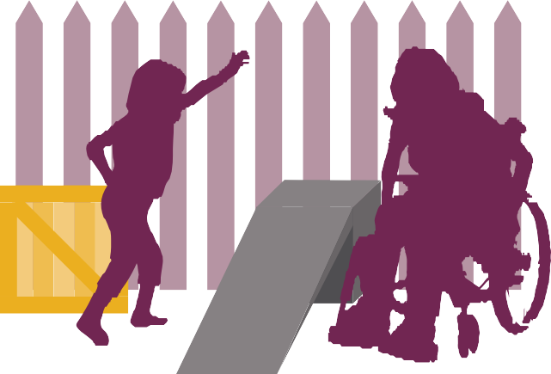


EQUALITY AND EQUITY
An equity approach aims to achieve the goal of equality.
Same treatment despite different barriers
Equitable treatment to overcome unique barriers
Systemic barrier has been removed
Notes:
Facilitator notes
Where gender norms, practices and structures lead to different outcomes that equate to disadvantage or harm for one group over another it is described as gender inequality. Gender inequality is a social condition characterised by unequal value afforded to men and women and an unequal distribution of power, resources and opportunity between them.
Gender equality and gender equity are often used interchangeably, but they are distinct.
Equality of opportunity is the outcome we are trying to achieve.
Equity is the process and means that people are treated differently depending on need and situation. Equity takes into account barriers and disadvantage that may have been created by economic situations, gender, language, racism, sexism, ageism and ableism.
The image aims to capture the difference.The first image shows how ineffective same or equal treatment can be. The second image shows equitable treatment – each person is given an equity measure according to their unique and diverse needs – much more effective. The third image shows the systemic barrier (i.e. literally the fence, figuratively the unequal norms, practice and structures) has been removed and all people can enjoy and watch the game equally.
Because women and men, and different groups of women, men and gender diverse people, do not have equal status in society, an equity approach is necessary.

Slide 19



SOCIO-ECOLOGICAL MODEL
Societal norms, cultural values.
Societal Level
System and Institutional Level
Organisational and Community Level
Public policies, laws, governments
NORMS
STRUCTURES
Schools, workplaces, sports clubs, public spaces.
Individual knowledge, attitudes, relationships with family and friends.
Individual and Relationship Level
PRACTICES
Notes:
Facilitator notes
Norms, practices and structures occur across multiple levels of society, supporting and reinforcing one another to influence gender unequal outcomes for women, men and gender diverse people.
The widespread and pervasive nature of gender inequality means that no one action or initiative will work to address it. Every person, organisation and community has a role to play.
Gender inequality is a complex historical issue that is deeply embedded at all levels of the socio-ecological model. It is important to unpack this to understand the causes and impacts of gender inequality in relation to people as individuals, how they operate in relationships and how this is either reinforced or challenged in the community and societal structure which we operate within.
For example, think about the widespread social and community norm that men are strong and able to physically protect themselves. How might this impact on a gay man experiencing violence from his husband? At an individual level, he may feel ashamed by his inability to protect himself (norm) and this might stop him from seeking support (practice). At an interpersonal level, this also stops him telling family and friends (practice) because he’s scared of being judged (norm). At an organisational level, there are limited family violence services he can access because many work only with women (practice and structure). At a systems level, he may hesitate to report the violence to the police fearing he might not be taken seriously as some people think that men can’t be victims (norm and practice). Here you can see how norms, practices and structures occur across all levels of the socio-ecological model, and how they reinforce each other in turn.
Explain the meaning of each level:
Individual: Personal knowledge, attitudes, rigid stereotypes and behaviours. These are impacted by every other level of the socio-ecology.
Examples:
Pressure to conform to limiting gender stereotypes
Women socialised to be fearful (restricting their social and civic life)
Relationship: Personal relationships with friends and family support or challenge stereotypes and norms and influence the individual’s own knowledge of gendered attitudes and behaviours.
Examples:
Negative impact of rigid gender roles in peer relations (for example, aggressive masculinities and submissive femininities)
Domestic violence and sexual assault
Organisational/community: Workplaces, schools and other social institutions have cultural norms, practices and policies that influence how they operate.
Examples:
Inequitable policies and culture of workplaces and social institutions (for example, inadequate parental leave policies)
Greater pay and value afforded to male dominated sectors
System/institutional: Systems, institutions and policies that either promote or fail to promote gender equality and women’s economic, legal and social autonomy.
Examples:
Women’s perceptions of safety in their communities
Male dominated community spaces and places (for example, sporting clubs)
Societal: Dominant social norms and stereotypes that influence each of the levels.
Examples:
Discriminatory laws and policies
Inequitable access to power and resources

Slide 20
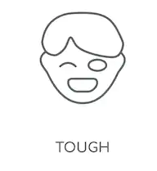

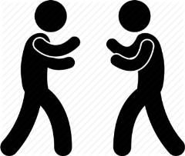

THE MAN BOX
Almost ½ of young Australian men think that guys should act strong even if they feel scared or nervous inside.
1 in 5 young men think that men should use violence to get respect if necessary.
Almost 2 in 5 men think a guy who doesn’t fight back when others push him around is weak.
Young men who follow and believe these rules strongly are far more likely to use violence and more likely to have thought about suicide.
Notes:
Facilitator notes
The Man Box: A study on being a young man in Australia, released in 2018 (The Men’s Project and Flood, 2018), was the first study that focused specifically on
the associations between attitudes to manhood or masculinity and the behaviours of Australian men aged 18-30. It involved a representative online survey of 1,000
young men from across the country.
The Man Box attitudes are a set of beliefs within society that place pressure on young men to act in a certain way. The initial report on the Man Box demonstrated that the Man Box attitudes are alive and well in Australia. Two thirds of young men said that since they were a boy they had been told a “real man” behaves in a certain way. While young men’s personal views are more progressive than what society is telling them, there is a substantial minority (averaging around 30 percent) of young men who endorse most of the Man Box rules.
The Man Box Study found men who form a rigid attachment to dominant norms and stereotypes of masculinity are more likely to display sexist attitudes and
behaviours, and are therefore more likely to perpetrate violence against women. Therefore challenging dominant and harmful forms of masculinity is part of the approach to help prevent violence against women.
Prompt
Ask students to think of some of the common stereotypes that men and boys internalise as they relate to violence, aggression and power and control, such as not crying or expressing emotion, being bullied with homophobic taunts, being encouraged to take physical risks etc.
Sources
Jesuit Social Services - The Man Box (jss.org.au)
Men in focus: unpacking masculinities and engaging men in the prevention of violence against women - Our Watch

Slide 21
GENDER INEQUITY IN CRIMINAL JUSTICE SETTINGS
Of the 140,000 sexual assaults reported to Australian police in the 10 years to 2017, almost 12,000 were rejected on the basis that police did not believe a sexual assault occurred (ABC).
While women represent 28% of the Victorian Police force, only 16% are in leadership roles. (VicPol)
“Loss of standing due to working part-time creates a cascading effect where women are less likely to be given ‘the big jobs’ which can impact on their opportunities to further progress.” As a result female officers in the NSW Police Force are under-represented in all leadership positions. (Elizabeth Broderick, 2019)
In the year ending June 2019, there were roughly 37 domestic and family violence offenders per 10,000 persons in NSW. Yet of more than 17,000 officers employed by NSW Police, last year just 11 were charged. (ABC)
Notes:
Facilitator notes
Highlight some of the examples that show gender inequity in the criminal justice system.
Prompts
Use these examples to prompt discussion about how students might see – or have seen – gender inequality playing out in their profession through inequitable gender norms, practices and structures.
Ask students to think of other examples, and describe why they are inequitable i.e. how they might lead to unequal outcomes for women, men or gender diverse people.
Sources
Abusers in the ranks https://www.abc.net.au/news/2020-10-19/police-in-australia-are-failing-to-take-action-against-domestic/12757914?nw=0
Final-Report-into-the-NSW-Police-Promotions-System.pdf (elizabethbroderick.com.au)

Slide 22
TOPIC 3
INTERSECTIONALITY AND GENDER INEQUALITY
Learning Outcomes
Understand the historical and cultural roots of intersectionality. Understand how it contributes to an understanding of oppression and privilege in society. Understand the difference between equity and equality.

Slide 23
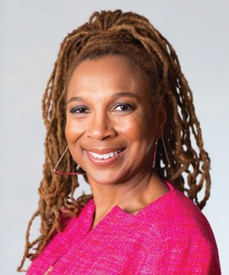
INTERSECTIONALITY
“
It’s basically a lens, a prism, for seeing the way in which various forms of inequality often operate together and exacerbate each other. We tend to talk about race inequality as separate from inequality based on gender, class, sexuality or immigrant status. What’s often missing is how some people are subject to all of these, and the experience is not just the sum of its parts.
INTERSECTIONALITY
Was first named as a concept by American law professor Kimberlé Crenshaw in 1989.
Kimberlé Crenshaw
Notes:
Facilitator’s notes
Let class know that ‘Intersectionality’ stems from Critical Race Theory, and presented a challenge to the way feminism had previously been conceptualized in America (it had been dominated by white women’s voices and concerns). Kimberlé Crenshaw originally used intersectionality to illuminate the way that in a legal context, Black American women suffered more discrimination than Black American men due to sexism and more discrimination that White American women due to racism.
For example, DeGraffenreid v. General Motors was a 1976 case in which five black women sued General Motors for a seniority policy that they argued targeted black women exclusively. The company did not hire black women before 1964, meaning that when seniority-based layoffs arrived during an early 1970s recession, all the black women hired after 1964 were laid off. A policy like that didn’t fall under just gender or just race discrimination. But the court decided that efforts to bind together both racial discrimination and sex discrimination claims — rather than sue on the basis of each separately — would be unworkable.
Since then intersectionality has been used to look at a diverse range of interlocking oppressions in addition to racism and sexism, such as ableism, hetero-sexism, age-ism and classism. We could also use intersectionality to productively illuminate how particular groups benefit from interlocking systems of privilege and advantage.
For example Audre Lorde referred to the ‘mythical norm’, which is a White, middle-class, cis-gendered, able-bodied man in his thirties. See following paper by Lorde: https://www.colorado.edu/odece/sites/default/files/attached-files/rba09-sb4converted_8.pdf
Because of systemic and everyday oppressions people do not have the same opportunities or the knowledge and confidence to access them. Often systems work best for the people who they were created by. An obvious example is the vast majority of buildings that do not cater to people who use wheelchairs.
Sources/resources
https://time.com/5786710/kimberle-crenshaw-intersectionality/
https://www.law.columbia.edu/news/archive/kimberle-crenshaw-intersectionality-more-two-decades-later
https://www.vox.com/the-highlight/2019/5/20/18542843/intersectionality-conservatism-law-race-gender-discrimination

Slide 24
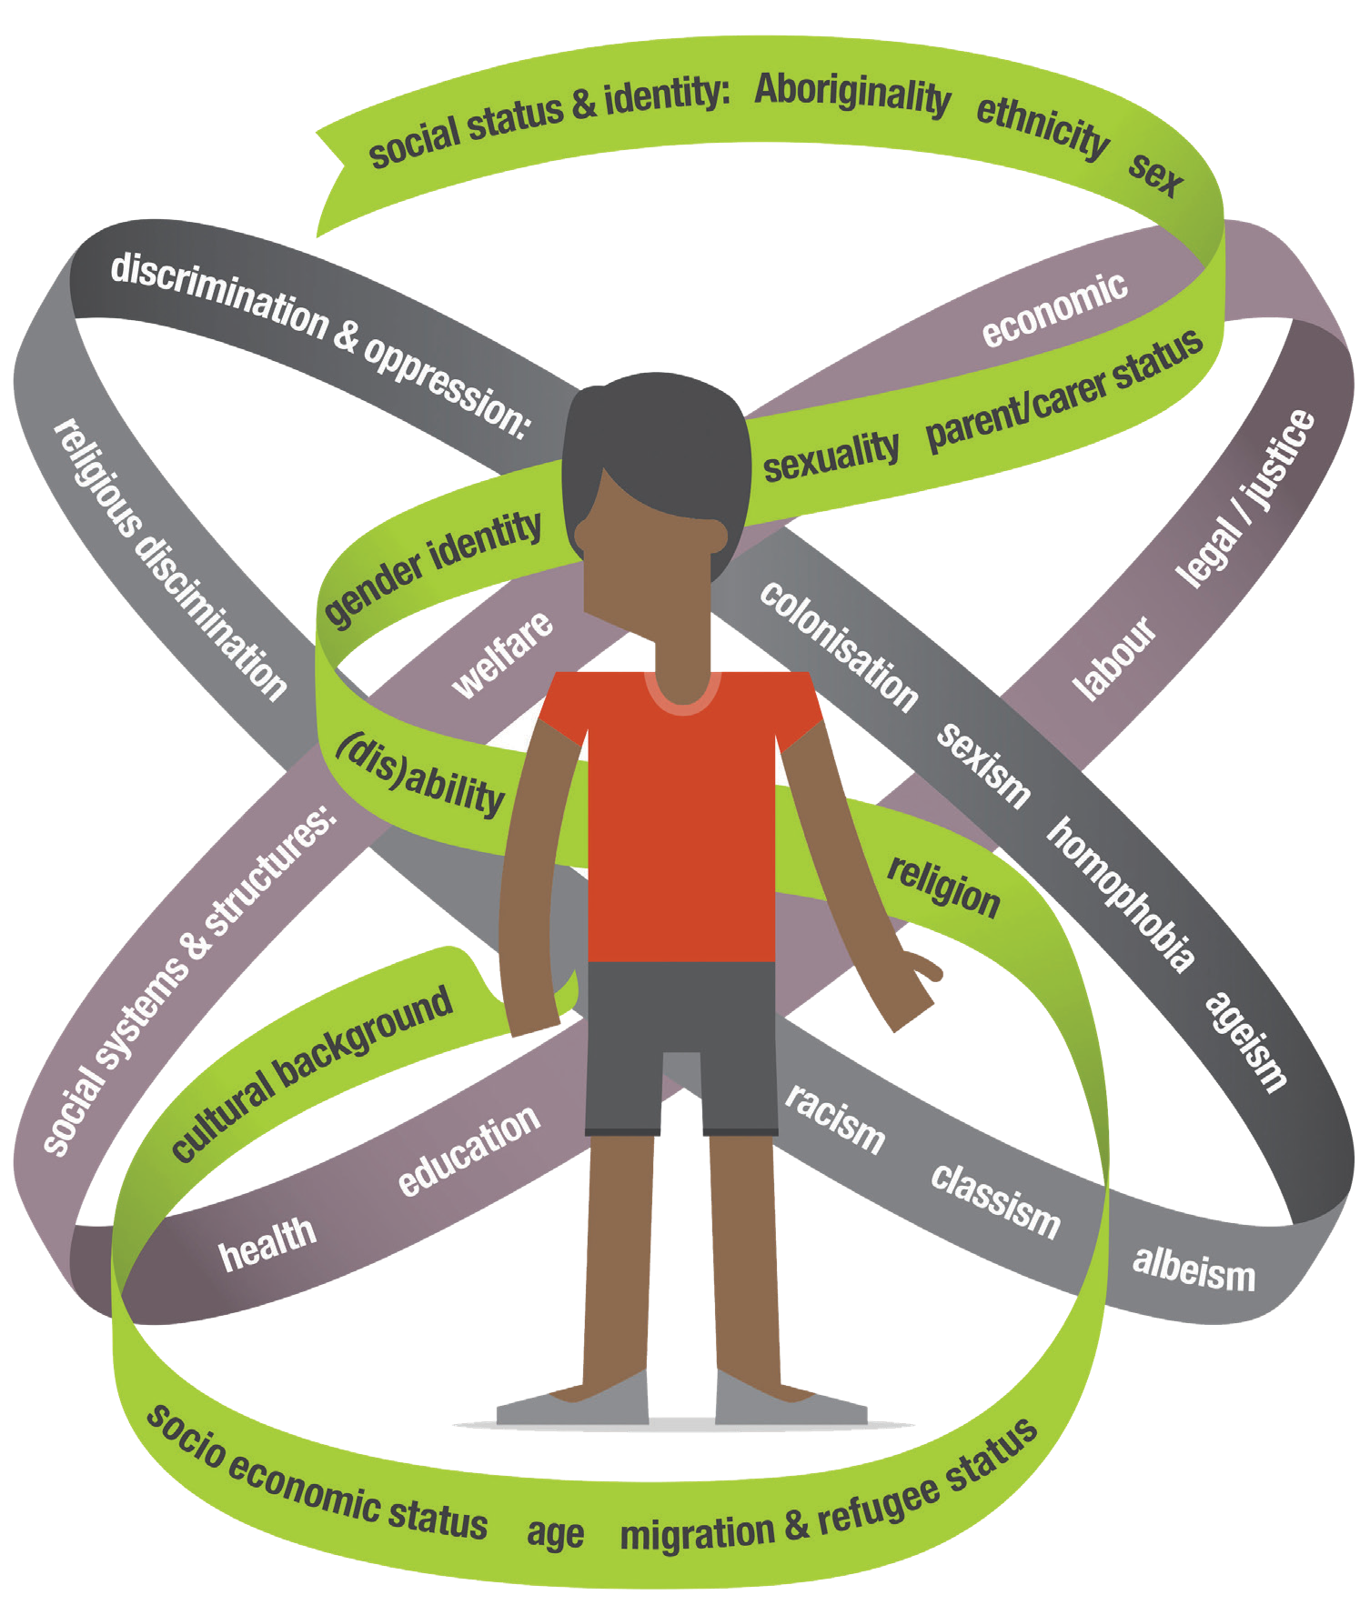
INTERSECTIONS OF POWER
Systems of discrimination & oppression
Colonisation, sexism, homophobia, ageism, ableism, classism, racism, religious discrimination.
Categories of social status & identity
Aboriginality, ethnicity, sex, parent/carer status, sexuality, gender identity, (dis)ability, religion, migration & refugee status, age, socio-economic status, cultural background.
Systems & structures of society
Welfare, economic, legal/justice, labour, education, health.
Notes:
Facilitator notes
Intersectionality presents a way of seeing or analysing the dynamics of power and social inequality in our society.
It’s a reminder that gender is not experienced in the same way by everyone. Our age, gender identity, life stage, ability, sexuality, Indigeneity, race, ethnicity, class, religious beliefs, family, geographical location and profession can all change our perceptions of gender as well as the way our gender is perceived and treated by law, policy, institutions and others.
The diagram (Our Watch, 2017) shows the layers of interaction between systems, forms of discrimination and social identities as they shape the experience of the individual.
Explain the ribbons:
The green ribbon represents the variety of factors that make up a person’s social status and identities. These factors are what we often consider when we address the issue of ‘diversity’.
The purple ribbon describes the social systems, which people can experience in a positive or negative way depending on their group membership.
The grey ribbon represents forms of oppression and discrimination which can form the basis on which people are excluded.
For example, a woman with a disability isn’t just at risk of experiencing sexism, but she may also experience ableism such as dealing with social stigma around her sexual expression, have difficulty getting access to contraception, face physical barriers to some spaces if she uses a wheelchair or not be taken seriously if she complains of her parent, guardian or partner making all her life decisions on her behalf. If she is a white woman with a disability her experience of fairness and justice may be different again to a woman of colour with a disability, who may experience racism in her daily life. All the systems and processes of advantage and disadvantage need to be taken into consideration in order to treat people with respect as humans first, and address any social, health or economic barriers they may face.
Intersectional feminism: Gender inequality is not experienced the same way by all women, nor expressed the same way in all contexts. For example, an Anglo-Australian, able-bodied woman, is likely to have a vastly different experience of sexism in the workplace than a recently arrived refugee or a woman living with a disability. To achieve equality and respect for all women, gender inequality cannot be seen as separate from other forms of discrimination and disadvantage that women face. Everyone’s identities, social positions and experiences are shaped not just by gender, but by a range of other social categories of difference, including Aboriginality, culture, race, ethnicity, faith, socio-economic status, ability, sexuality, gender identity, education, age, and migration status. The consideration of how people experience multiple and intersecting forms of discrimination and disadvantage is referred to as ‘intersectionality’. The image below illustrates the various systems and structures which affect people differently.
Prompts
Ask students to reflect on the types of advantage or disadvantage they are familiar with experiencing themselves.
What systems of discrimination and oppression might be influencing this experience?

Slide 25
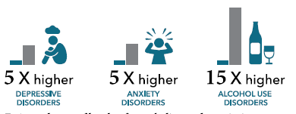
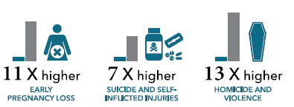
GENDER AND COLONISATION
Gender inequality in Australia intersects with racism and the ongoing impacts of colonisation.
Europeans imposed patriarchal norms, practices and structures in the process of colonisation of Australia.
There is a tendency for available services to work in silos rather than respond to Indigenous health issues in an integrated manner.
SPECIFIC IMPACTS ON ABORIGINAL WOMEN
Increased risk of depression, anxiety, alcohol use, early pregnancy loss, suicide, self-harm, homicide and violence.
Notes:
Facilitators notes
It can be easier to talk about the oppression of African Americans and People of Colour in an American context than talk about the oppression of Aboriginal and Torres Strait Islanders in Australia.
Intersectionality provides a lens that is applicable to the disadvantage experienced by Aboriginal and Torres Strait Islander Australians.
While gender inequality is a global phenomenon, in the Australian context its roots lie in the patriarchal colonial culture that was introduced with colonisation. For Aboriginal and Torres Strait Islander people, the particular patriarchal norms and values, practices and structures that were imposed were at odds with their existing cultures.
The ongoing impacts of a history of genocide and colonization mean that Aboriginal and Torres Strait Islanders face significant systemic racism and disadvantage. Experiences of gender inequality cannot be separated from experiences of racism and racial discrimination, nor from the ongoing impacts of colonisation and colonial violence. These experiences are part of what has been called ‘the “double bind” of gender and racial discrimination and oppression’ for Aboriginal and Torres Strait Islander women.
Service providers observe that it can be extremely difficult to provide effective intervention and support for many Aboriginal and Torres Strait Islander women, as violence is often co-occurring with one or more other health and wellbeing concerns. These may include but not be limited to, childhood trauma, substance misuse, and mental and physical health issues. For example, treatment for drug and alcohol misuse is less likely to be effective when the woman is also experiencing untreated violence and vice versa. Providing support to a woman experiencing violence can be equally as challenging when she is also presenting with mental health or substance misuse issues which are not being treated effectively.
Service provider challenges aside, many Aboriginal and Torres Strait Islander people experience significant frustration at the tendency for available services to work in ‘silos’, rather than respond to their various needs in an integrated and holistic manner.
Resources:
Changing the picture - Our Watch
Changing the picture background paper - Our Watch

Slide 26
TOPIC 4
ADDRESSING GENDER-BASED VIOLENCE
Learning Outcome
Understand that gender-based violence is serious, prevalent and preventable. Describe the four gendered drivers of violence and the essential actions to address violence.

Slide 27
TERMINOLOGY
Gender-based Violence
Refers to a broader range of acts of violence against women, such as family violence, dating violence, sexual assault and harassment. It can occur in the home, in public, in workplaces and in education institutions. Gender-based violence includes:
Violence Against Women
Acts of gender-based violence against women and girls. Most gender-based violence is perpetrated by men against women. In Australia approximately 95% of all male victims of violence and 94% of female victims report a male perpetrator.
Sexual Assault and Sexual Harassment
Unwanted or unwelcome sexual behaviour, including unwanted touching and sexual penetration, exposure to sexual acts, and sexual images taken without consent.
Family and Domestic Violence
Acts of violence, coercion and control perpetrated by someone in a family or family-like relationship, most commonly occurring in the home or in private.
Violence Against LGBTIQ+ People
Internationally, there is emerging evidence and increasing recognition that gender-based violence also includes harmful acts directed towards someone because of their gender- such as someone from the lesbian, gay, trans, intersex, queer and questioning (LGBTIQ+) community.^{ii}
Notes:
Facilitator notes:
Explain to the participants that throughout this training, you will use the term ‘gender-based violence’. This is a broader term that encompasses all the types of violence experienced by women, girls and LGBTIQ+ people, and across multiple contexts. Gender-based violence is not just physical – it includes behaviours that are controlling or cause psychological, emotional or financial harm, as discussed in the previous slide.
Many participants may be more familiar with the terms ‘family violence’, ‘domestic violence’, and ‘sexual assault and sexual harassment’, and we still use these terms when we are talking about specific contexts or types of violence.
Note that of course non-LGBTIQ men experience violence too and that all forms of violence are serious. However, the prevalence and nature of gender-based violence means we need to pay specific attention to it and we need to address preventing it in a particular way.
The statistic on pertaining to male perpetration of violence is evidence in the 2015 ABS Personal Safety Survey, The Mens Project, 2018 and Our Watch, Change the Story, 2015.
Potential resistance:
You may experience resistance to the idea that women and LGBTIQ people experience higher rates of some forms of violence than men. This will be covered further in the session, but helpful statistics include:
1 in 3 Australian women (34.2%) has experienced physical and/or sexual violence perpetrated by a man since the age of 15. (Australian Bureau of Statistics, 2017)
Recent data shows that 75 per cent of victims of family violence are women. (Victorian Government, 2018)
One in two adult Australian women has experienced sexual harassment during their lifetime (Australian Bureau of Statistics, 2017)
Emerging evidence suggests intimate partner violence is experienced at similar or higher rates in same-sex couples as in heterosexual couples, and that experiences of sexual violence and abuse may be higher, particularly for transgender and gender diverse people (Rainbow Health, 2020).
Sources/resources
Australian Bureau of Statistics, 2017. Personal Safety Survey, Australia, 2016, ABS cat. no. 4906.0. Canberra: ABS.
Victorian Government, 2018. Safe and Strong: A Victorian Gender Equality Strategy. Melbourne: Victorian Government.
Rainbow Health, 2020. Pride in Prevention. Melbourne.

Slide 28
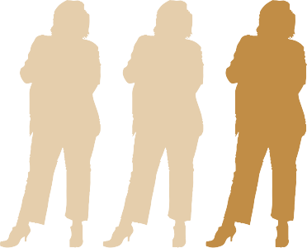
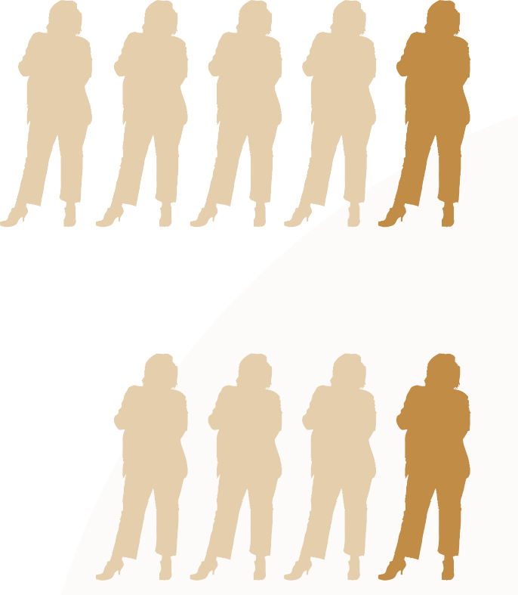
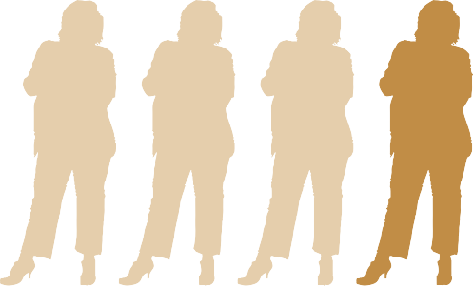
A NATIONAL CRISIS
1 in 3 Women
Have experienced physical violence.
Nearly 1 in 5
Women
Have experienced sexual violence.
1 in 4 Women
Have experienced workplace sexual harrassment.
1 in 4 Women
Have experienced physical violence by a current or former partner.
Notes:
Facilitator notes:
Briefly introduce these statistics, and explain to the students:
Violence against women is prevalent, and has a profound impact on women’s health and wellbeing, on families, communities and our society:
Violence from a current or former partner is the third greatest health risk factor for women aged 25-44, with the first being childhood abuse and neglect (AIHW 2019)
Domestic or family violence is a leading driver of homelessness for women (AIHW 2020)
In Australia, one woman is killed every nine days by a current or former partner; and every day, 12 women are hospitalised for assault injuries due to family and domestic violence (AIHW 2019)
Violence against women is costing Australia up to $26 billion each year (KPMG 2016)
Emerging evidence of LGBTIQ+ people’s experience of violence shows:
Same-sex couples (including men) experience partner violence at similar or higher rates as heterosexual couples
Experiences of sexual violence and abuse may be higher, particularly for transgender and gender diverse people (Rainbow Health Victoria 2020)
Women who identify as lesbian or bisexual experience far higher rates of sexual violence than heterosexual women (de Visser et al., 2014)
One in five LGBTIQ+ Australians has experienced physical forms of homophobic abuse (AHRC 2014)
All forms of violence are unacceptable, whether it is perpetrated by men or women. Family, domestic and sexual violence is overwhelmingly perpetrated by men against women:
One in five women and one in 20 men have experienced sexual violence since the age of 15 (ABS 2017)
Women are nearly three times more likely than men to have experienced violence from a former or current partner (ABS 2017)
Recent data from the Victorian Government shows that 75 per cent of victims of family violence are women (Victorian Government 2018)

Slide 29


TYPES OF VIOLENCE
Different types of abusive and violent behaviour:
VIOLENCE CREATES
FEAR
POWER
CONTROL
Physical
Social
Emotional & Psychological
Financial
Cultural & Spiritual
Sexual
Notes:
Facilitator notes:
Briefly discuss examples of different types of abusive and violent behaviour including non-physical forms of coercion. Some examples are:
Physical violence: murder, strangling, choking, punching, throwing objects, reckless driving, cruelty to pets, damage to possessions
Social abuse: includes isolating from friends or family, controlling someone’s appearance, monitoring phone calls or messages, controlling who someone can speak to or see
Emotional/psychological abuse: threats of suicide or self-harm to get someone to do what you want, criticising or blaming someone, implying or spreading rumours of mental illness, minimising or dismissing someone’s feelings or experiences, mind games and ‘gaslighting’ (denying or distorting the truth and causing someone to question their own reality/sanity)
Financial abuse: limiting or denying someone access to finances, incurring debt in someone’s name, not allowing someone to work
Cultural/spiritual abuse: using culture or religion as an excuse for abuse, denying someone the right to practice their religion or engage in cultural/spiritual practices
Sexual violence: rape, forcing or coercing someone to engage in sexual acts, denying choice in contraception
Inform participants of the following points:
All forms of violence – including non-physical forms of coercion and control – are harmful, and can have devastating long-term impacts on our communities and society.
What is common across the different types of violence is that they are used to create fear and enforce power and control over another person or people in a relationship.
Violence in a relationship is not usually a single act or incident, but a pattern of coercive, humiliating or threatening behaviour that forces people to change their day-to-day behaviour – often in ways that they do not want to – due to fear of more violence and abuse.

Slide 30



GENDER AND EXPERIENCES OF VIOLENCE
Women are more likely to experience violence:
Men are more likely to experience violence:
From a man.
From another man.
At the hands of a current or former partner.
At the hands of a stranger.
In a private place.
In a public place.
With a higher risk of serious injury and homicide.
That results in fear or anxiety.
Notes:
Facilitator notes:
The evidence also shows that women and men in Australia experience violence differently.
Men are more likely to experience violence from strangers and in a public place. Men are more likely to have one-off experiences of violence than women. The nature of men’s experiences means it is more likely that emergency services will respond quickly.
Women are more likely to know the perpetrator (often their current or former partner), and the violence usually takes place in their home. Women’s experiences of violence are rarely one-off incidents, but are part of a coercive pattern of behaviour with violence increasing in severity and frequency over time. Women can live with violence over a period of weeks, months and years. Women are more than twice as likely as men to experience fear or anxiety due to violence from a former partner, and the nature of their experience often means there is more responsibility placed on them to seek support and/or report violence.

Slide 31
GENDERED VIOLENCE: MAKING THE LINK
Murder
Rape
Sexual Assault
Physical & Emotional Abuse
Sexual Harassment
Gender inequality is what lies below the surface driving gender-based violence
Disrespect of Women
Sexist Jokes
Unequal Pay
Harmful Gender Stereotypes Sexist Language
Notes:
Facilitator notes:
Gender inequality is what lies below the surface driving violence against women.
Evidence shows that violence against women is much more likely to occur when power, opportunities and resources are not shared equally between men and women in society, and when women are not valued and respected as much as men Our Watch, VicHealth, ANROWS, 2015
Research tells us that there are four key drivers of violence against women. Our Watch, VicHealth, ANROWS, 2015

Slide 32
DIFFERENT EXPERIENCES OF VIOLENCE
“
“
Some migrant and refugee women may experience controlling behaviours by their partner or extended family using immigration or visa status.
El-Murr 2018
Aboriginal women are 32 times more likely to be hospitalised as a result of family violence than other women.
AIHW 2018
“
“
Women and girls with disabilities are at least twice as likely to experience violence as those without disability.
Family violence perpetrated against LGBTI people occurs at similar rates to family violence perpetrated against non-intersex, heterosexual, cis-gendered women.
Our Watch 2017
Woodlock et al. 2014
Notes:
Facilitator notes:
Colonisation, racism, ableism, homophobia, transphobia, biphobia and other forms of discrimination interact to make the experience of gendered violence more prevalent or severe for some groups of women.
Talk through the statistics on this slide to highlight that violence is not experienced by all women and LGBTIQ+ people in the same way, and people who face multiple forms of discrimination and inequality experience violence more frequently, more severely, over a longer period of time, and in additional forms (such as denying a women with disability access to her medicine or mobility aids, or threatening to ‘out’ a LGBTIQ+ person).
Make clear that this violence is perpetrated by a range of perpetrators – for instance, both Aboriginal and non-Indigenous men perpetrate violence against Aboriginal women, and immigrant women can experience violence from both immigrant or non-immigrant men.
Sources:
AIHW 2018
Woodlock et al. 2014
El-Murr 2018
Our Watch 2017
Additional information about violence against women with disabilities
Economic abuse is a common form of violence experienced by women who come into contact with OPA. Examples of economic abuse included perpetrators controlling women’s money, prostituting women and keeping the money for themselves and using Powers of Attorney to facilitate economic abuse (particularly large transactions involving money or property)
Whilst men as intimate partners were found to be the most common perpetrators, fathers, brothers, sons, male carers, male acquaintances and strangers were also found to have perpetrated violence against women with disabilities.
As noted, perpetrators may perceive women with disabilities as being easy targets because of stereotypical attitudes about women with disabilities, for example, women being seen as incompetent and voiceless. These stereotypes often become overwhelming barriers when women attempt to seek help, as they are seen as not being credible witnesses or are not listened to when they make attempts to tell others about the violence. Perpetrators may target women because there are low rates of detection and it might be easier to isolate women with disabilities in the privacy of their homes where they are dependent on them for assistance
Sources
Woodlock Delanie, Healey Lucy, Howe Keran, McGuire Magdalena, Geddes Vig and Granek Sharon: Voices Against Violence Paper One: Summary Report and Recommendations (Women with Disabilities Victoria, Office of the Public Advocate and Domestic Violence Resource Centre Victoria, 2014).
Women With Disabilities Australia, University of New South Wales and People with Disabilities Australia, Stop the Violence: Improving Service Delivery for Women and Girls with disabilities, Sydney, (2013).
Voices against violence – WDV, DVRCV 2014

Slide 33





COMMON MISCONCEPTIONS ABOUT THE DRIVERS OF VIOLENCE
Some of these are ‘Reinforcing Factors’ that increase the frequency, severity or longevity of violence, but do not themselves drive it.
Stressors of Poverty
Alcohol/Drug Abuse
Mental Health
Poor Anger Management Skills
Violent Upbringing/ Childhood Experience of Violence
Stress
Notes:
Facilitator notes
Stress: In the aftermath of bush fires or increases in industrial communities where many male workers have lost their jobs. BUT If stress drives violence, then we would see it perpetrated more equally across the genders – as women also experience stress.
Alcohol is a feature in a disproportionate number of police call-outs to family violence and is correlated with a higher number of, and more severe incidents of violence against women. BUT Not all violence against women involves alcohol, nor does alcohol consumption (even when it is excessive) always result in violence. AND Not all people who drink are violent, and many people who do not drink perpetrate violence against women.
Mental illness: Research shows us that people with mental health issues are equally as likely as the general population to commit violence. However, people with mental health issues are much more likely to be victims of family violence than the general population.
Anger management issues: Most perpetrators of violence against women have no problem managing their anger and emotions in other contexts (for example, at work or in the general community).
Most victims do not go on to become perpetrators and most perpetrators were never victims. Many victims of violence against women and children (both male and female) go on to become some of the strongest advocates against violence. They often become highly attuned to identifying controlling and abusive behavior and do not associate with people displaying these sorts of behaviours. It is also important that boys who are victims of violence and abuse in childhood are seen and supported as victims of violence –not as future perpetrators - and it is harmful and disrespectful to male victims to reinforce this myth.
This does not provide an adequate explanation for why most men are not violent or sexual assault perpetrators. An excuse.
Reiterate- these can contribute to but are not the key drivers of VAW. i.e. Individual level factors may be relevant but they don’t explain why most men to whom they apply, are not violent, and why other men not exposed to any of these factors are violent.

Slide 34
MISCONCEPTIONS ABOUT FAMILY VIOLENCE
Violence only happens in poor families.
Alcohol and drugs are casual factors.
MYTH
MYTH
It is true that police are more likely to become involved in reports of family violence in lower socio-economic groups. However, we know that violence does take place across society and in all kinds of homes. There are no reliable figures on prevalence, given it is largely self reported. We can’t assume it takes place only in poor areas.
Research shows that alcohol and drugs can increase the severity of violence, but is not a causal factor. Most people who drink, including alcoholics, are not violent to their families.
FACT
FACT
Notes:
Facilitator notes
There are many misconceptions about what family violence is and why it occurs.
Use this slide to explore the myths and facts if you think it will be helpful to students to have further background on the issue.
More examples of myths and facts can be found at Domestic and family violence: Myths and misunderstandings
There are also many myths related to family violence that occurs within communities that are commonly subordinated from mainstream society, such as refugee and migrant groups, Aboriginals and Torres Strait Islanders, and LGBTIQ people.
Resources
Domestic and family violence: Myths and misunderstandings
Challenging myths about culture and violence in migrant and refugee communities – Multicultural Centre for Women's Health

Slide 35
WHY DIDN’T SHE LEAVE?
There are powerful barriers that prevent some women from leaving abusive relationships.
Some of them are:
She loves him and values his good qualities. She is economically dependent on him.
He has destroyed her other relationships, she has no other emotional support.
Fear of failure. Our culture has put the burden of a successful marriage on the woman.
Religious beliefs about marriage.
Not wanting to deprive the children of their father. He tells her each incident will be the last one.
Fear of more violence — research indicates that the point of leaving is the most dangerous time for a woman. This has implications for our reporting.
Notes:
Facilitator notes
There are many complex emotions connected to being a victim/survivor of violence. Frequently people feel guilt and shame, fear and distress. They may love the perpetrator and be worried about what will happen if they disclose their experience of violence.
When the perpetrator is their spouse, they may also believe that marriage is for life or that their success and acceptance in society is dependent on making a relationship work.
For refugee and migrant women, for example, there can also often be fear (founded on threats from the perpetrator) that they will be forced to leave the country.
Furthermore, because of systemic and everyday oppressions such as racism, sexism, ableism, hetero-sexism, ageism and the ongoing impacts of colonialism in Australia, not everyone has the same access to information, services and legal protections. These barriers can make it more difficult for some people to seek support.

Slide 36
GENDERED DRIVERS
Blaming a survivor for not reporting family violence because she doesn’t feel safe talking to the police.
Condoning violence against women.
Men’s control of decision-making and limits to women’s independence.
Underrepresentation of women in senior leadership roles.
Rigid gender stereotyping and dominant forms of masculinity.
Ads for childcare only feature heterosexual families.
Cultures of masculinity that emphasise aggression, dominance and control.
Male colleagues ganging up to harass or bully a female colleague.
Notes:
Facilitator notes:
The evidence base tells us that gender inequality creates the social conditions for gender-based violence to occur. There are four key expressions of gender inequality that have been found to predict or drive this violence:
Condoning violence against women, where violence is downplayed, excused, justified or denied, or where blame is placed on the victim rather than with the perpetrator. This does not have to be intentional. For example, an email telling female students to be more careful walking through the campus at night after a violent assault occurs.
Rigid gender roles and stereotypes, where fixed beliefs and assumptions are held that people are naturally suited to different tasks or have different interests or abilities based on their gender or sexuality. For example, if marketing campaigns for childcare features only heterosexual couples and families
Men’s control of decision-making and limits to women’s independence, where women’s autonomy in both public life and private relationships is constrained. For example rigid gender roles where men feel pressure or are expected to be the breadwinner.
Men disrespecting women to bond with other men, through actions that are sexist, disrespectful or hostile to women.
Tailor the examples of each driver to the students discipline where appropriate.
Activity
Break students into four groups, and assign each group a driver. Ask students to brainstorm other examples of what their driver looks like in daily life, either at a university, in their course learning or placement experience. After 20 minutes, ask each group to share some examples they came back with.
If short on time, do not complete the activity – just show this slide and/or the next few slides that show examples of what each driver looks like, and discuss briefly.
You can choose to show the next few slides as groups report back if it supports the conversation

Slide 37
CONDONING VIOLENCE AGAINST WOMEN
BLAMING ALCOHOL, MENTAL ILLNESS OR STRESS
“He was really drunk.” “He just snapped.”
HIGHLIGHTING THE VICTIM’S BEHAVIOUR MORE THAN THE PERPETRATOR’S VIOLENCE
“What did she expect dressed like that?”
COMMENTS OR JOKES ABOUT VIOLENCE EXPERIENCED BY TRANS PEOPLE
“I’d get angry too if I found it wasn’t a real woman.”
EXCUSING AGGRESSIVE BEHAVIOUR
“Treat ‘em mean, keep ‘em keen.”
BELIEVING MEN CAN’T CONTROL
THE NEED FOR SEX
“All they think about is sex anyway.”
Notes:
Facilitator notes:
You may choose to show this slide to support – or instead of – the group reporting back with examples of what condoning violence against women looks like in daily life.
Responses may include:
A workplace or organisation failing to hold a staff member or student accountable for sexual harassment.
Believing women find it flattering to be persistently pursued, even if they’re not interested.
Minimising intimate partner violence between two men because ‘men should be able to take care of themselves.’
Sexual harassment policies that focus only on reporting, without onus or organisational duty of care or on bystanders to take action.
Mistrusting women’s reports of violence – 42% of Australians think it is common for sexual assault accusations to be used as a way of getting back at men.
Media portrayals of men who use violence as protective, mentally ill, alcoholic or drug addicts, minimising or excusing their choice to use violence.
Excusing reports of violence in aged care or disability care homes as carer stress.

Slide 38
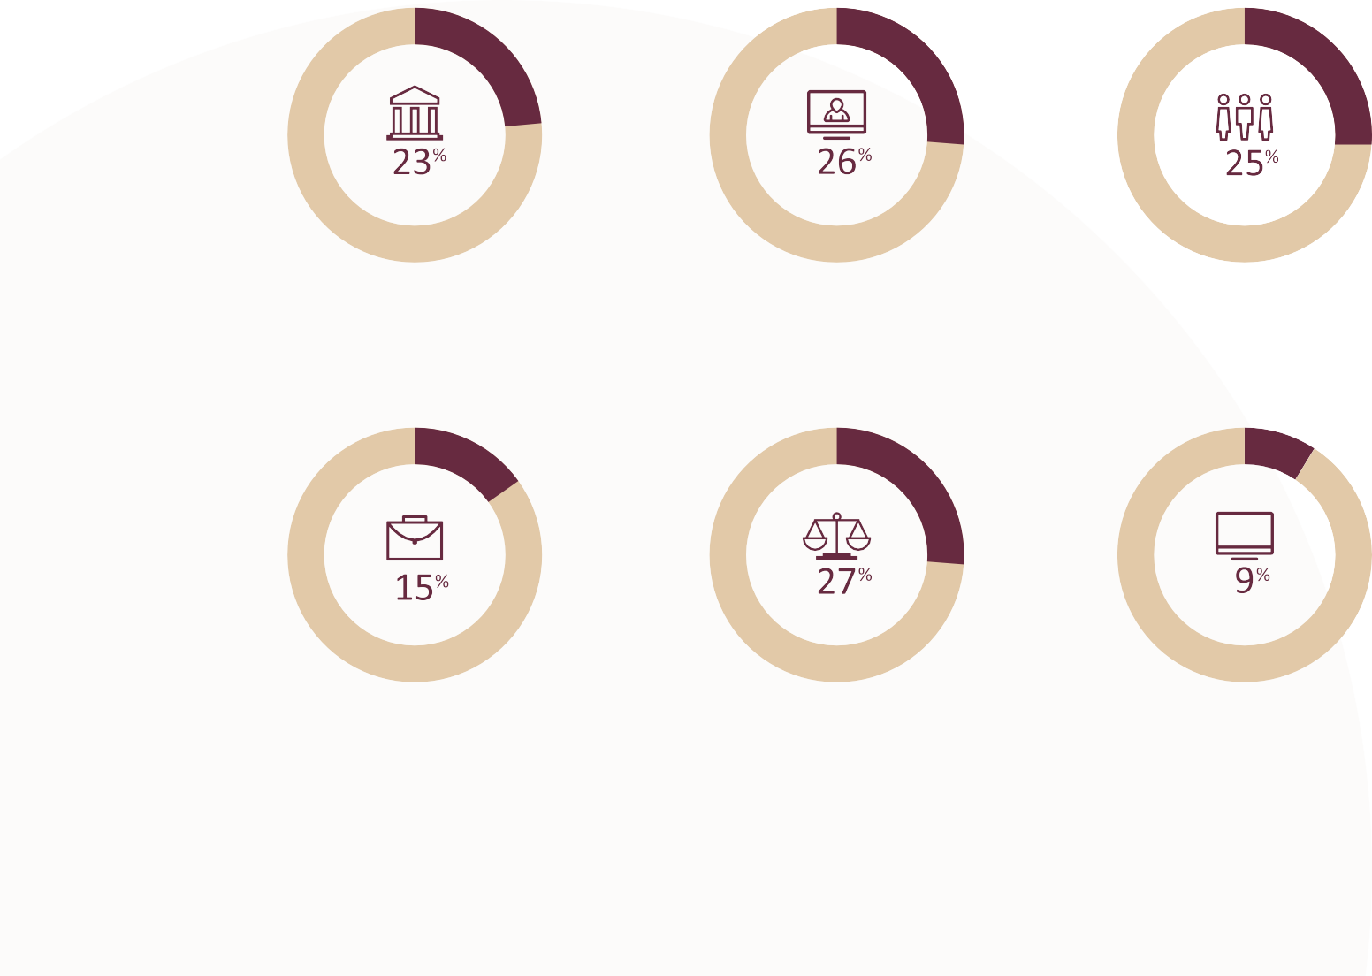
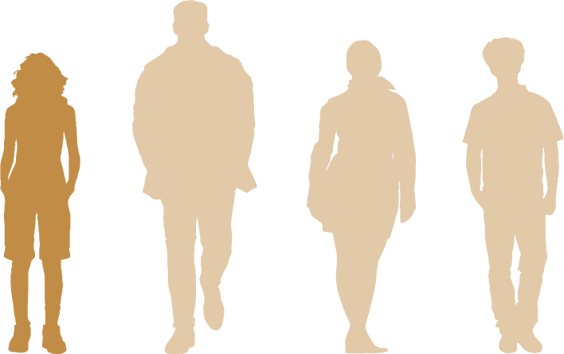
MEN’S CONTROL OF DECISION-MAKING AND LIMITS TO WOMEN’S INDEPENDENCE
Globally women make up...
There are fewer women in top roles of the ASX 200 companies than there are men called John, Peter or David.
National Parliamentarians
News Media Leaders
Senior Managers
Corporate Board Members
Judges
Senior IT Leaders
1 in 4 Australians
believe women prefer a man to be in charge of the relationship.
Notes:
Facilitator notes:
You may choose to show this slide to support – or instead of – the group reporting back with examples of what men’s control of decision-making and limits to women’s independence look like in both public life and in relationships.
Responses may include:
Expectation that the man in a heterosexual relationship is the primary earner, and should control decisions about spending, assets and bank accounts.
Men’s dominance of speaking time in tutorials and both men and women interrupting women more frequently than they do men in meetings.
Men dominate leadership roles in organisations, even in female-dominated industries.
Underrepresentation of women in parliament and other positions of political representation. Female-dominated industries such as health and human services and education having significantly lower levels of pay than male-dominated industries and occupations.
Workplaces that fail to offer adequate flexible working arrangements for both women and men, such as part time roles, making it more difficult for families to decide caring arrangements.
Women’s portrayal in entertainment and the media through their relationship or connection to male protagonist, rather than as their own independent/multi-dimensional characters.
Sources:
Global Institute for Women’s Leadership 2021
Webster et al. 2017
Liveris 2017

Slide 39

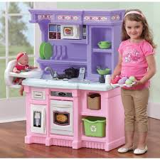
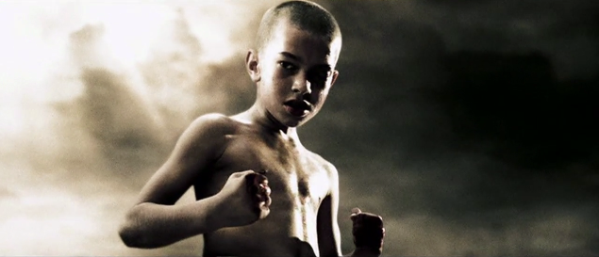
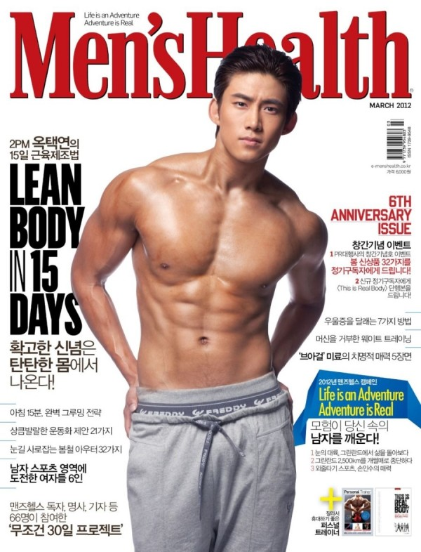


RIGID GENDER STEREOTYPING
Men as the primary breadwinner.
Assuming women will do the cleaning, cooking or administrative tasks at work or community events.
Unequal parental leave policies available for men and women based on the stereotype and expectation that women will be the main family caregiver.
Intersection of racism and sexism can result in specific stereotypes – e.g. Black women as masculine, or Asian men as effeminate
People with a disability are often penalised when expressing their sexuality and gender identity
Older women are often dismissed and treated as invisible or irrelevant.
Notes:
Facilitator note:
You may choose to show this slide to support – or instead of – the group reporting back with examples of what restrictive gender stereotypes look like in daily life.
You may choose to emphasise that:
Gender stereotypes are often deeply embedded and unconscious, and we learn them from being saturated with messages and norms from the day we are born. They can seem ‘natural’ because we are exposed to them from before we are even conscious of it.
These stereotypes affect LGBTIQ+ people too, either by excluding or othering them, or by creating expectations that they must fit into rigid gendered roles within their relationships or families in order to be accepted.
Gender stereotypes are harmful for everyone including men because they restrict and limit individuals into narrowly defined roles, interests, attributes and behaviours.
Strict ideas about women and men’s roles, identities and relationship can contribute to a culture where violence, harassment, and criticism is used to ‘punish’ people who step out of their expected roles.
Responses may include:
Male nurses being questioned or challenged for entering a job traditionally considered to be women’s work.
Gendered dress codes and school uniforms that restrict girls’ movement and limit their capacity to participate in sports.
Unequal parental leave policies available for men and women in organisations, based on the stereotype and expectation that women will be the main family caregiver.
Lesser value of women’s sporting achievements, demonstrated through lower professional athletes’ salaries, media coverage and sponsorship opportunities.
The double standard where men displaying assertiveness and leadership qualifies are admired, while women with the same qualities may be considered bossy or cold.
Assumptions that men are more practical, rational and decisive than women, which may result in women being underrepresented in leadership or decision-making roles.

Slide 40
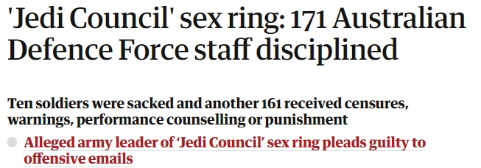
CULTURES OF MASCULINITY THAT EMPHASISE AGGRESSION, DOMINANCE AND CONTROL
“
St Kevin’s College issues apology after student’s sexist chant on Melbourne tram.
This was locker room banter, a private conversation that took place many years ago.
1 in 3 Australians
believe it’s natural for a man to want to appear in control of his partner in front of his male friends.
Donald J. Trump
1 in 4 Australians
believe women prefer a man to be in charge of the relationship.
Notes:
Facilitator notes:
You may choose to show this slide to support – or instead of – the group reporting back with examples of what men disrespecting women to bond with other men looks like in daily life.
Responses may include:
College chants, hazing and initiation rituals that allow and promote abuse and disrespect towards women.
The norms that some things are OK to talk about in male peer groups, but not acceptable in ‘mixed company’, e.g. ‘locker room talk’.
Joking that someone only got the job as a ‘diversity hire’.
Women in male-dominated workplaces or industries are told to ‘man up’, be ‘one of the boys’ and expected not to get upset at sexist jokes or sexualised treatment.
Men telling degrading jokes about women or bragging about their sexual conquests as a way to bond with male peers, e.g. ADF Skype scandal.
Boys and young men consuming and sharing images or video of women without their consent, e.g. ADFA Skype scandal.
All-male sports commentary panels where degrading or demeaning talk about women is laughed off or ignored.
Online communities built on demeaning or humiliating women are allowed to remain active due to lack of enforceable standards to shut them down.
Sexualised objectification of women is used as a marketing strategy for sport or gaming.
If challenged about whether or not something is inappropriate, explain that no one is saying that people can’t make jokes but that jokes at the expense of others that perpetuates harmful stereotypes or treats people differently because of their characteristics (like gender, race, sexuality or disability) is tacitly supporting inequality.
Sources:
Davidson 2014
Silva 2019
Webster et al. 2017

Slide 41
STOPPING VIOLENCE AT ITS SOURCE
Response
Supports survivors and holds perpetrators to account (and aims to prevent the recurrence of violence).
Tertiary
Early Intervention
Aims to ‘change the trajectory’ for individuals at higher-than-average risk of perpetrating or experiencing violence.
Secondary
Primary Prevention
Whole-of-population initiatives that address the primary (‘first’ or underlying) drivers of violence.
Primary
Notes:
Facilitator notes:
Public health evidence tells us prevention is the most effective way to eliminate violence from our society.
A primary prevention approach means stopping violence before it starts. It means changing the behaviours and norms, across all levels of society, that excuse, justify or allow violence against women and LGBTIQ+ people to occur.
This approach is guided by a well-established evidence base, and is similar to the approach taken for other major social issues like smoking.
Primary prevention sits alongside other work to address gender-based violence. Secondary (early intervention) and tertiary prevention (response) focus on providing information and services to people experiencing, or at risk of experiencing, gender-based violence. While essential, early intervention and response are unlikely to significantly reduce rates of violence on their own.
Primary prevention takes a whole-of-population approach to addressing the drivers of violence. In universities, this means engaging the whole university community – staff, students, visitors, partners – in work to prevent violence.

Slide 42
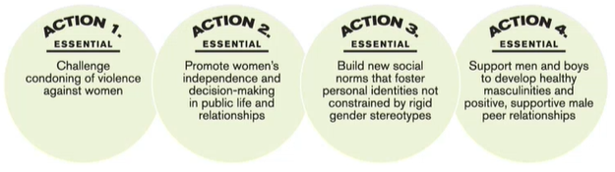
ESSENTIAL ACTIONS TO ADDRESS THE GENDERED DRIVERS
Notes:
Facilitator notes
Essential actions 1–4 are designed to target the four specific gendered drivers of violence. Each of these four essential actions addresses a specific gendered driver.
Challenging the condoning of violence against women includes having university policies and processes that show sexual harassment is a serious issue, raising awareness about the prevalence and impact of different forms of violence, and making sure university communications about violence highlight the perpetrators’ responsibility rather than victims’ clothing or behaviour.
To address men’s control in decision-making and limits to women’s independence, we must promote women’s independence and decision-making in public life and in their relationships. This means supporting women’s leadership in all its forms, and promoting alternatives to ‘how things have always been done’. For example, rolling out leadership training and mentoring programs for women, or promoting flexible work arrangements for both men and women
To address rigid gender stereotyping, we need to promote positive personal identities that are not restricted by stereotypes, and challenge gender roles. For example, using the arts and media to explore different male role models, providing unconscious bias training for people on recruitment panels, promoting flexible employment conditions for men, or encouraging women and girls’ participation in STEM.
To address men disrespecting women to bond, we must support men and boys to develop healthy masculinities and positive, supportive male peer relationships. For example challenging homophobia as an expression of masculinity at an individual, relationship, peer, organisational and institutional level.

Slide 43
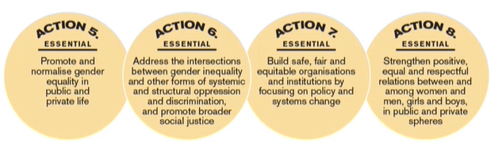
ESSENTIAL ACTIONS TO ADDRESS THE SOCIAL CONTEXT OF INEQUALITY
Notes:
Facilitator notes
Essential actions 5–8 address the broader social context – gender inequality and other forms of structural and systemic discrimination and oppression that gives rise to violence against women. While these actions are essential, they are not sufficient in themselves to shift the prevalence of violence against women, since they do not specifically focus on the gendered drivers. They must be undertaken together with actions 1–4, which target the four gendered drivers.
5. Promote and normalise gender equality in public and private life, for example increase social and structural support for gender equality in workplace policies that support flexible work and pay equity and address sexual harassment in the workplace.
6. Address the intersections between gender inequality and other forms of systemic and structural oppression and discrimination, and promote broader social justice, for example form partnerships and coalitions to address the collective challenges of gender inequality, sexism, racism, colonialism, ableism, ageism, classism, homo-, bi- and transphobia, and heteronormativity and cisnormativity in collaborative ways
7. Build safe, fair and equitable organisations and institutions by focusing on policy and systems change, for example address masculine organisational cultures through prevention work targeted at settings where groups of men gather and interact, such as specific social venues and sports clubs, as well as through male dominated organisations and institutions.
8. Strengthen positive, equal and respectful relations between and among women and men, girls and boys, for example build organisational and institutional cultures that promote and demonstrate the importance of equality, respect, safety and fairness in professional contexts.

Slide 44
AN INTERSECTIONAL APPROACH TO PREVENTING GENDER-BASED VIOLENCE
Women are not only unequal to men, there are also inequalities between groups of women.
Focusing on gender inequality alone is not enough.
We need to address other forms of inequality and discrimination to prevent violence against women.
Notes:
Facilitator notes
While understanding and identifying the drivers in the working context is the primary prevention approach, students also need to be away of how women across all backgrounds can be impacted differently by gender-based violence and may need tailored support and approaches to overcome unique barriers that result form intersecting forms of discrimination.
Prompts
Return to the previous slide and ask students to identify what be an example of one of the actions taking an intersectional approach.
For example, in the context of women with disabilities who might directly experience the gendered drivers of violence:
There are intersections of gender inequality and ableism
‘protection’ is often used as an excuse for behaviour that controls or limits the movement of women and people with a disability
women with disabilities experiencing abuse often struggle to be heard or believed, even when they disclose abuse to others
It’s important to not present any individuals as being inherently more ‘vulnerable’ than others, but rather recognise that larger systemic and structural forms of oppression and marginalisation make people vulnerable.
Resources
Unpacking Violence: A storytelling resource for understanding nonphysical forms of abuse and the gendered drivers of violence against women - Our Watch

Slide 45
TOPIC 5
DEALING WITH RESISTANCE TO GENDER EQUITY
Learning Outcome
Understand why resistance occurs and what it looks like. Identify proven approaches for minimising and dealing with resistance.

Slide 46
DERAILING THE CONVERSATION
Have you been on the receiving end of any of these statements? When?
“You’re overly sensitive.”
“You probably just misunderstood.”
“You’re arguing with opinions not fact.”
“I haven’t had it easy either.”
“You’re taking things too personal.”
“Can you prove that your experience is wide-spread?”
“If you weren’t so hostile, people might listen to you more.”
Notes:
Facilitator’s notes
Use these statements as a way into understanding backlash and resistance. Ask students to discuss times that they’ve been on the receiving end of these statements or heard them. Ask them to share the context of the conversations.
Turn the discussion towards gender and sexuality and racism if students are not already there.
Derailing a conversation or shutting it down through undermining the other person’s perspective and suggesting that it as personal issue rather than a societal concern is a key characteristic of backlash and resistance.

Slide 47
RESISTANCE AND BACKLASH
“What’s all this gender equality stuff? I made my way up by working hard, not by asking for special treatment.”
Backlash is a normal part of the change process when things change, many people’s response is to push back because they feel uncertain, threatened or disagree with the change being proposed.
Backlash is a term for the resistance, hostility or aggression which can arise as a reaction to change that an individual or group thinks is unnecessary or unjust.
When working to prevent violence against women, backlash is essentially any effort or behaviour which seeks to halt change and revert to status quo gender relations, re-establishing male privilege and power.
“It’s not the role of the workplace to be messing with people’s private lives.”
Notes:
Facilitator notes
Point out that men tend to be more conservative in terms of gender equity discussions, initiatives and change but a proportion of women are also more resistant to change
‘Women may have investments in the very patterns of gender that have disadvantaged them. Some women make a patriarchal bargain where they go along with gender inequalities that disadvantage them in some ways because they can find some rewards or status in them.’ Michael Flood, VicHealth.
Resources
https://media-cdn.ourwatch.org.au/wp-content/uploads/sites/2/2019/02/15002447/PG_Dealing-with-backlash_UpdatedFeb2019.pdf
https://www.vichealth.vic.gov.au/-/media/ResourceCentre/PublicationsandResources/PVAW/Encountering-Resistance-Gender-Equality.pdf
https://www.vichealth.vic.gov.au/letter/articles/vh-letter-47-backlash
https://www.mav.asn.au/__data/assets/pdf_file/0019/21673/Gender-2018-3.-Managing-backlash-and-resistance-Dr-Michael-Flood.pdf

Slide 48
FORMS OF RESISTANCE
Denial
Appropriation
Denial of the problem or the legitimacy of the case for change.
Simulating change while covertly undermining it.
Disavowal
Co-option
Refusal to recognise responsibility.
Using the language of progressive frameworks and goals (‘equality’, ‘rights’, ‘justice’, and so on) for reactionary ends.
Inaction
Refusal to implement a change initiative.
Repression
Reversing or dismantling a change initiative.
Appeasement
Efforts to placate or pacify those advocating for change in order to limit its impact.
Notes:
Facilitator notes
Resistance can take a range of forms, including:
Passive denial techniques which seek to ignore or minimise the impact of gender inequality and maintain the status quo, for example ‘There’s no problem here’.
Appropriating or co-opting change efforts, for example ‘What about men’s rights?’.
Backlash, which looks like active and aggressive opposition that has the aim of reversing or dismantling any change achieved.
Prompts
Ask student to think of examples of when they have observed or experienced different types of resistance. Ask how the resistance was dealt with and how effective it may have been.

Slide 49
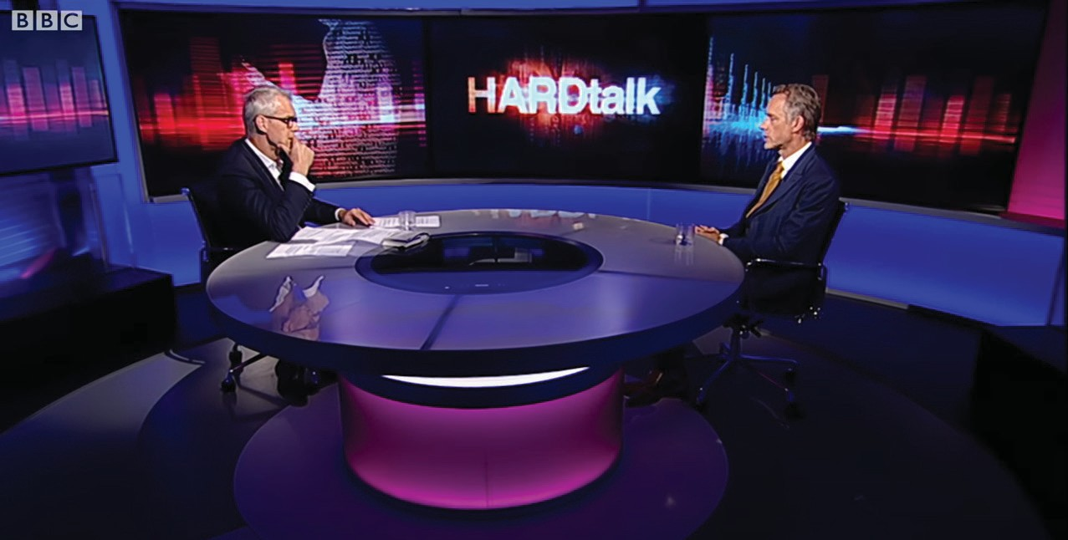
BACKLASHERS CLAIM A BACKLASH AGAINST MASCULINITY
Jordan Peterson on the ‘Backlash Against Masculinity’ - BBC News
Notes:
Facilitator notes
Psychologist, academic and men’s rights advocate Jordan Peterson insists that there is a backlash against masculinity.
Tell students this is a good example of resistance.
Watch
Jordan Peterson on the 'backlash against masculinity' - BBC News – YouTube (3:38)

Slide 50

SPECTRUM OF RESISTANCE
Curious
‘Movable Middle’
Entrenched Opposition
Fully Committed
Unconvinced
Notes:
Facilitator notes:
The spectrum of resistance shown in the diagram helps us to understand the different ways resistance is expressed, and why. People at the left-hand end of the spectrum of resistance – the entrenched opposition – are the least likely to join and support your argument, and the social norms in our culture reinforce their prejudices. Research has found that focusing on the ‘moveable middle’ – that is, on the people who are curious, or unconvinced about certain facts and evidence – is the best starting point for change.
Source
VicHealth. (2018). Encountering resistance: Strategies to respond to resistance to gender equality initiatives. Victorian Government.

Slide 51


ADDRESSING RESISTANCE
Don’t be surprised.
Understand the form and who it’s coming from.
Be willing to listen.
Frame, don’t shame.
Use facts and evidence to support your statements.
Defend against derailing techniques.
Notes:
Facilitator notes ​
1. Don’t be surprised ​
Resistance is to be expected. Prepare for it. Resistance means your work advocating for equality is getting traction. ​
​
2. Understand the form ​and who it’s coming from
Resistance takes different forms. Thinking through the form will help in crafting your responses. Tailor your messaging to your audience to address their concerns or correct misinformation. ​Entrenched opposition won’t be convinced. Understand when to respond and when to leave it alone. Find allies and focus on the ‘moveable middle’. ​
​
3. Be willing to listen ​
Create spaces for diverse views and experiences to be expressed. When people can have their say and talk about their own beliefs, biases and fears without being shut down, they are more likely to be open to other messages. ​
4. Frame, don’t shame
Tell real-life stories about gender equality and allow personal accounts to be shared to help people connect emotionally, not just rationally, to the concepts. Note the benefits of equality to both men and women, and address myths and misinformation. ​
​
5. Use facts and evidence to support your statements
6. Defend against derailing techniques ​
Derailing techniques are used to gain power over others. Recognising them helps you respond effectively. For example, if you’re asked, ‘Can’t you take a joke?’, that’s the domination technique of ridiculing. The defensive strategy for this is to ask more questions – immediately inviting them to explain what they meant by that. The confirmation technique is to give respect and space for others, confirming that you take contributions seriously. ​

